Slide 1
Digital Preservation for the Masses:
Using Archivematica and DSpace as Solutions for Small-sized Institutions
(and other options)
Digital Commonwealth Annual Conference 2012

Slide 2
Joseph Fisher
Database Management Librarian @ UMass Lowell
  Electronic Resources
  Digitization Projects
    MBLC ILS grant to digitize the Paul E. Tsongas Congressional Papers
      Additionally included Lowell Historical Building Surveys
    Current proposal to digitize Tewksbury Almshouse records
  Digital Commons repository
  Digital Scholarly Services – NSF data management planning
Vice President Digital Commonwealth

Slide 3
Agenda
Why Digital Preservation
For whom
What it is
How to approach it
OAIS and TRAC
Basic requirements
Solutions
  DuraCloud
  LOCKSS
  DSpace
  Archivematica

Slide 4
where this information originates
Graduate (2011) University of Arizona SIRLS
Graduate Certificate Program in Digital Information Management (DigIn) digin.arizona.edu
Digital Preservation Management Workshop: Implementing Short-term Strategies for Long-term Problems (attended 2004 (Cornell) and 2010 (ICPSR) @ MIT)
SAA Digital Archives Specialist (DAS) program
Nine workshops and exams required for DAS Certificate
24 workshops currently in four sections with 8 online

Slide 5
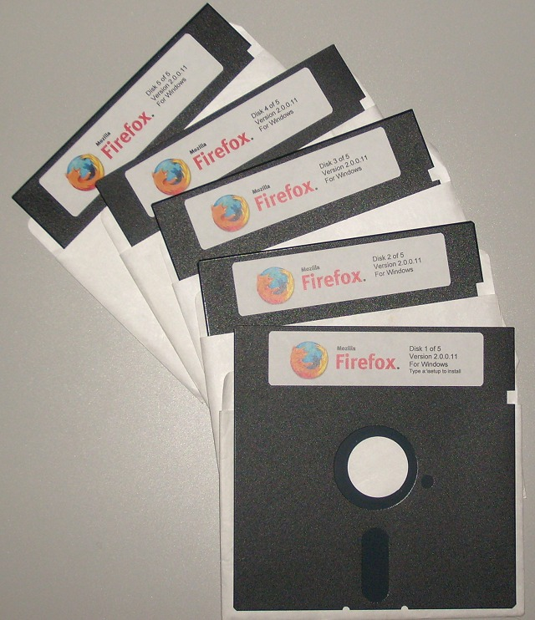
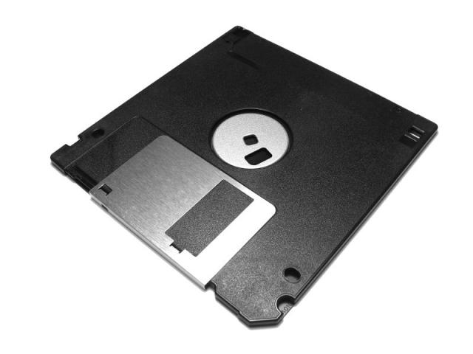
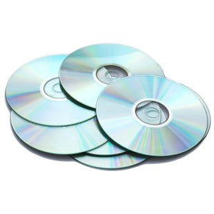
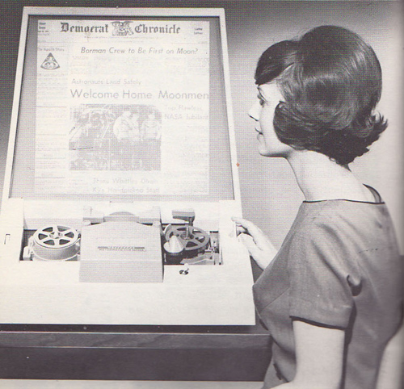
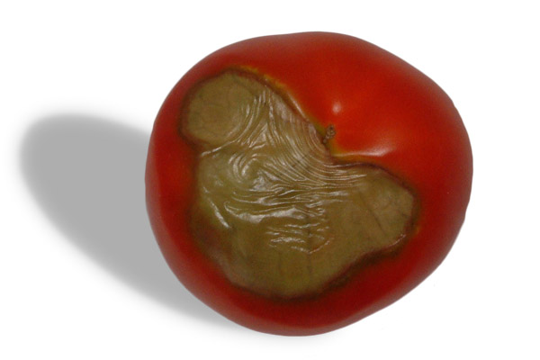
Why is digital Preservation Important??
Obsolescence!! Bit Rot!!

Slide 6
not just for libraries & archives anymore
Researchers – coming soon to a government grant near you – Data Management Planning
Record Managers – born digital tsunami
People – personal archiving
  “Indeed, we are now all our own librarians.”
    Ellysa Stern Cahoy, Penn State University Libraries
    The Signal: Digital Preservation, Library of Congress blog, 4/9/2012
    http://blogs.loc.gov/digitalpreservation/2012/04/the-challenge-of-teaching-personal-archiving/

Slide 7
Digital Preservation: What is it?
“The series of managed activities to ensure continued access to digital materials for as long as necessary.” DCP Handbook. Digital Preservation Coalition (2008)
Managed activities: “defined very broadly…refers to all of the actions required to maintain access to digital materials beyond the limits of media failure or technological change.”
Access: “continued, ongoing usability of a digital resource, retaining all qualities of authenticity, accuracy, and functionality deemed to be essential for the purposes the digital material was created and/or acquired for.” [see “significant properties”]
Authenticity: “the trustworthiness of the electronic record as a record…. that whatever is being cited is the same as it was when it was cited unless the accompanying metadata indicates any changes.”

Slide 8
Five Organizational Stages
Acknowledge: Understanding that digital preservation is a local concern
Act: Initiating digital preservation projects
Consolidate: Segueing from projects to programs
Institutionalize: Incorporating the larger environment and rationalizing programs
Externalize: Embracing inter-institutional collaboration and dependency.

Slide 9
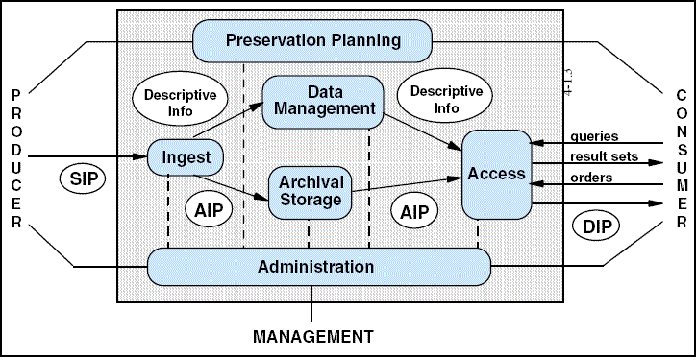
OAIS Reference Model
(Open Archival Information System)
  The Consultative Committee for Space Data Systems
  (CCSDS) released in 1999

Slide 10
SIP – Submission Information Package (Producer)
  Appraisal & Accession – Validate & Verify
  Virus protection & Checksum
  file normalization (PDF/A)
  metadata – description, preservation, structural
AIP – Archival Information Package (Management)
  Store digital object(s) and associated metadata
  Dublin Core, MODS, PREMIS, METS package
  Refresh, migrate, error-check, replace
DIP – Dissemination Information Package (Consumer)
  Retrieval, delivery, and security
  Monitor Designated Community for changing needs

Slide 11
what is the
Open Archival Information System?
It’s “Open” in the flexible sense of an outline, framework, or blueprint.
And an “Information System” in the sense of a comprehensive, integrated, and complex conceptual construct.
ISO 14721:2003
a collection of six high-level services, or functional components, that, taken together, fulfill the OAIS’s dual role of preserving and providing access to the information in its custody.

Slide 12
Six Core OAIS Requirements
Negotiate and accept appropriate information from Information Producers
Obtain sufficient intellectual control of the information to ensure Long-term preservation
Determine the scope of the Designated Community
Ensure the information is understandable by the Designated Community without the assistance of the information producers
Follow clearly documented policies & procedures to ensure the information is preserved against all reasonable contingencies
Make the information available to Designated Community

Slide 13
TDR and TRAC
Trustworthy Repositories Audit & Certification
Categories:
  Organizational Infrastructure
    Governance, organizational structure, staffing & viability
    Procedural accountability & policy framework
    Financial sustainability, contracts, licenses, & liabilities
  Digital Object Management
    Ingest -- preservation strategies & processing procedures
    Workflows, documentation, records, & audit procedures
    Unique identifiers, metadata, & verification testing
    preservation planning & strategies
    Access policies & designated community interaction
  Technologies, Technical Infrastructure, & Security
    Software, updates, security
    Checksum error-checking
    Backups & disaster recovery

Slide 14
ISO 16363
The standard is titled the Trusted Digital Repository (TDR) Checklist
Based upon the Trusted Digital Repositories and Audit Checklist (TRAC)
CCSDS publication (Magenta Book) Sep. 2011
  (The Consultative Committee for Space Data Systems)
ISO approved standard for publication in Mar. 2012
working group also wrote and submitted ISO 16919, entitled, Requirements for Bodies providing Audit and Certification

Slide 15
Basic Requirements of Digital Preservation
The more copies the safer
  Replicate data on multiple storage systems
The more independent the copies the safer
  Save in different geological locations
  Save on different technology system types
The more frequently the copies are audited by checksum error checking the safer
  Audit or scrub the replicas to detect damage, and repair by overwriting the bad copy with a good copy
  David S. H. Rosenthal
  “Bit Preservation: A Solved Problem.” International Journal of Digital Curation. 1.5 (2010)

Slide 16
SIP to AIP
  Save and maintain at least one copy of file kept exactly as is in it’s original file format
  Convert copy for public use to PDF or JPEG
  Plan to migrate use copy as format changes
  Normalize copy to preservation format if necessary
    Word doc to PDF/A1b
  Possibly migrate copy of Word doc as format changes
  Dublin Core descriptive record and maybe a MODS record also in XML
  PREMIS record in XML – preservation metadata
  METS record in XML – structural metadata

Slide 17
So what are some options?
DuraCloud
LOCKSS
Dspace
Archivematica

Slide 18
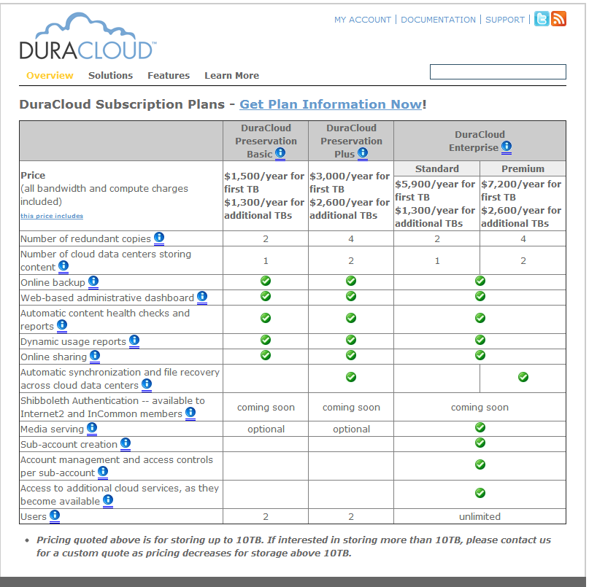

Slide 19
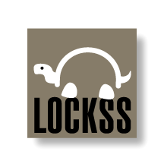
Began development 1991 (beta release 2001)
Still managed out of Stanford
Global LOCKSS hosted at Stanford
Private LOCKSS Networks (PLN) to preserve manuscript and image collections, data sets, etc.
Example is MetaArchive Cooperative
  First year server purchase $4,600
  $1 /GB/year + $5,500 or $3,00 annual membership
  1 TB = $24,100 for 3 years for sustaining member
  Good example of a TRAC audit report (PDF available)
At least 6 nodes (so 6 copies)
Maintain storage server

Slide 20
DSpace
HP-MIT Libraries Alliance (2002)
DuraSpace (2009)
Current version 1.8.2 (24 Feb. 2012)
Linux / Windows (Java)
“DSpace preserves and enables easy and open access to all types of digital content including text, images, moving images, mpegs and data sets.”
Beginning with 1.7 (Dec. 2010) began adding significant digital curation functionalities

Slide 21
DSpace Development
1.7.0 released 17 Dec. 2010
  Discovery – enables faceted searching
  AIP backup and restore – Duracloud integration
    Export/import entire hierarchy, community, or collection
  Curation System (CS)
    Profile collection based on format type
    Check that required metadata fields are present
    Enhance/replace/normalize an item’s metadata or content
    Checksum checker
1.8.0 released 4 Nov 2011
  Bulk metadata editing
  SWORD client – push content to other SWORD repositories
  Rewrite Creative Commons license
  Virus checking during submission
3.0 projected Oct/Nov 2012
  Version number scheme changing to 2 digits
    Major release increments 1st digit & bug fixes 2nd digit
    Item-level versioning – features from Dryad Project

Slide 22
DSpace Installation
Prerequisite Software :
Linux or Windows
Oracle Java JDK
Maven (Java build tool for stage 1)
Ant (Java build tool for stage 2)
PostgreSQL or Oracle
Tomcat
Perl

Slide 23
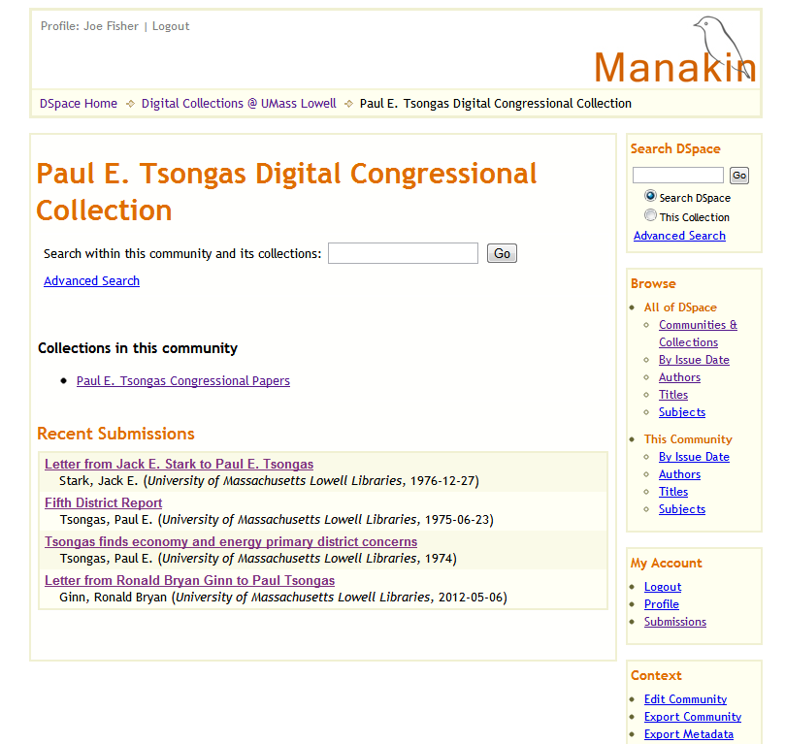

Slide 24
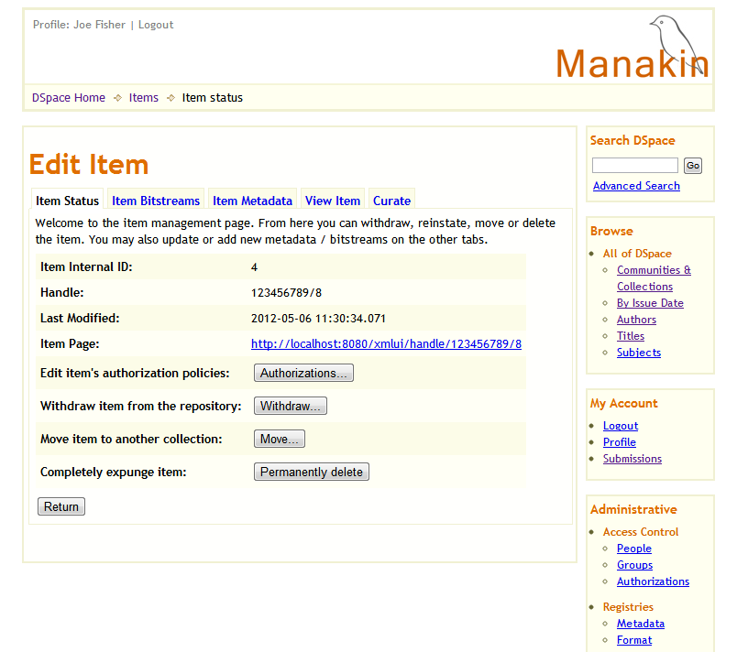

Slide 25
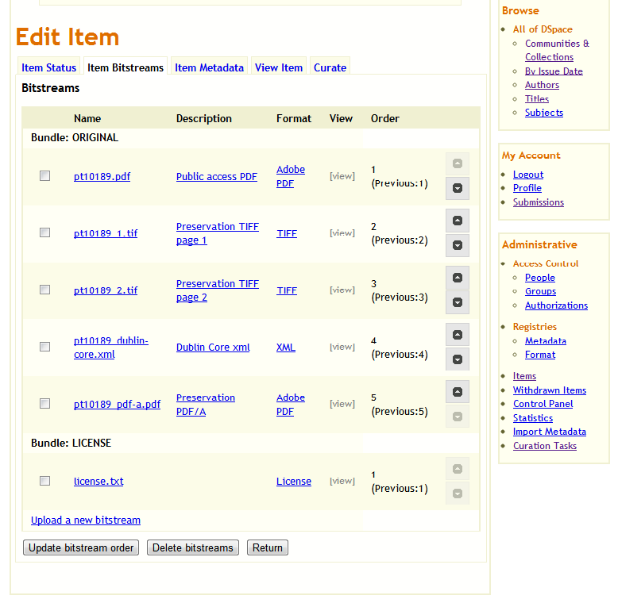

Slide 26
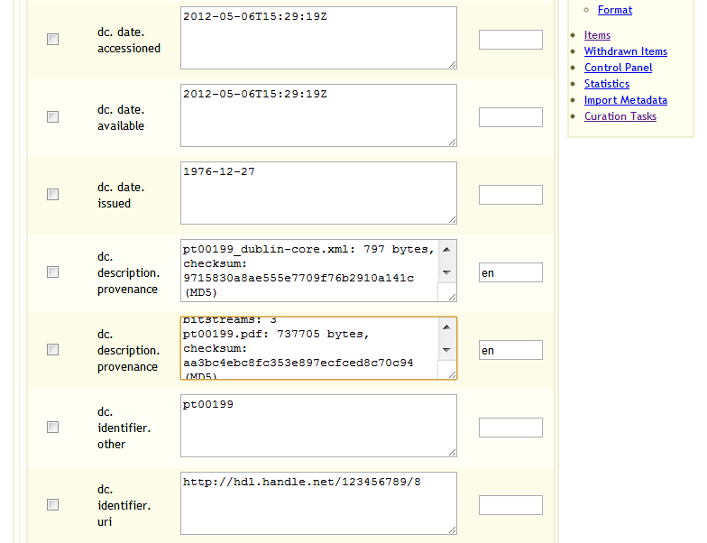

Slide 27
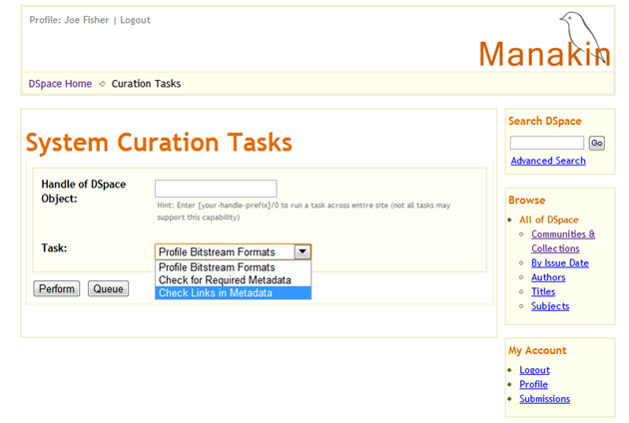

Slide 28
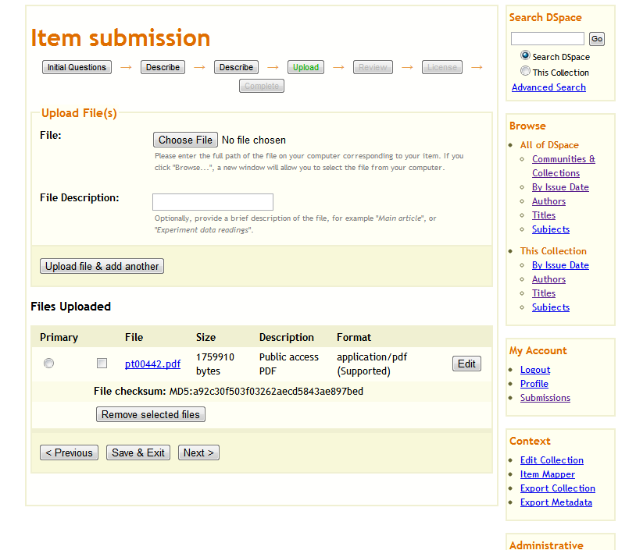

Slide 29
Archivematica
A free and open-source digital preservation system.
Uses a micro-services design pattern to provide an integrated suite of software tools that allows users to process digital objects from ingest to access in compliance with the ISO-OAIS functional model.
Managed by Artefactual Systems (Toronto) in collaboration with the UNESCO Memory of the World's Subcommittee on Technology, the City of Vancouver Archives, the University of British Columbia Library, the Rockefeller Archive Center, Simon Fraser University Archives and Records Management, and a number of other collaborators.

Slide 30
Archivematica Development
0.6 alpha release 19 May 2010
0.7 alpha release 18 Feb. 2011
0.8 alpha release 3 Feb 2012
  Complete standards-compliant PREMIS in METS implementation
  Multiple normalization options
  Ability to ingest DSpace exports

Slide 31
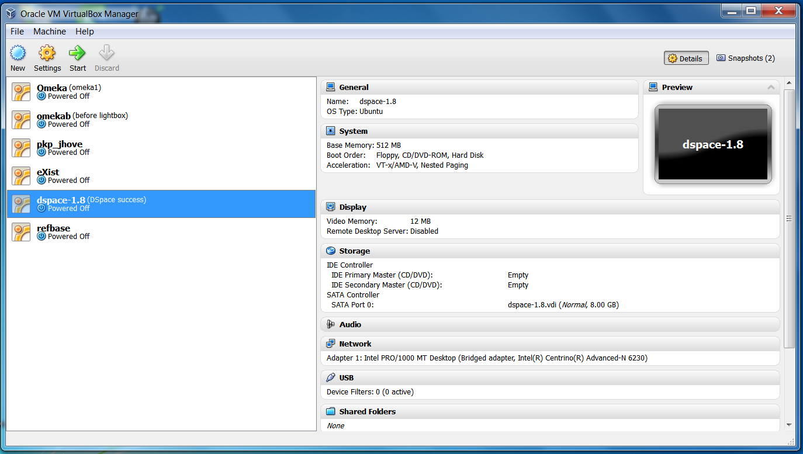
Archivematica Appliance Installation in Oracle VM VirtualBox
Install Open Source VirtualBox

Slide 32
Download Archivematica appliance file
http://archivematica.org/downloads/archivematica-0.8-alpha-vmdk.tbz
Requires something like 7Zip to unpack to this tar file:
    archivematica-0.8-alpha-vmdk2.tar
Which you then unpack yet again to the appliance installation file:
  archivematica-0.8-alpha.vmdk

Slide 33
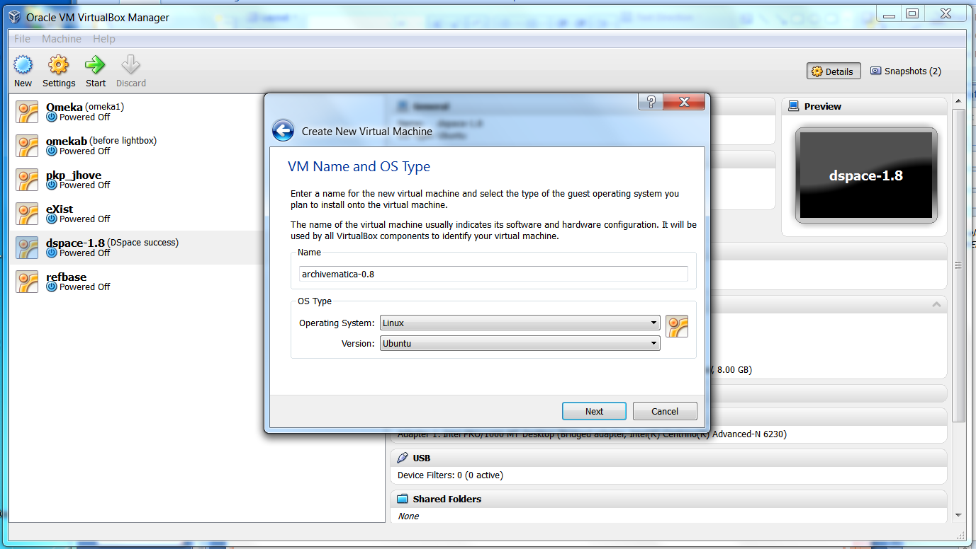
Create New VM and Assign OS to Linux/Ubuntu

Slide 34
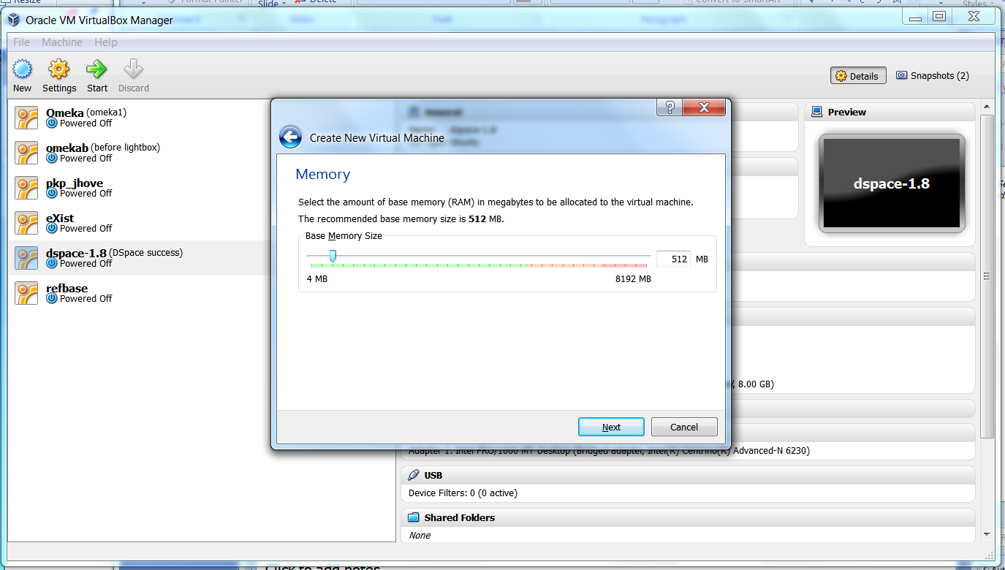
Accept default Memory allocation

Slide 35
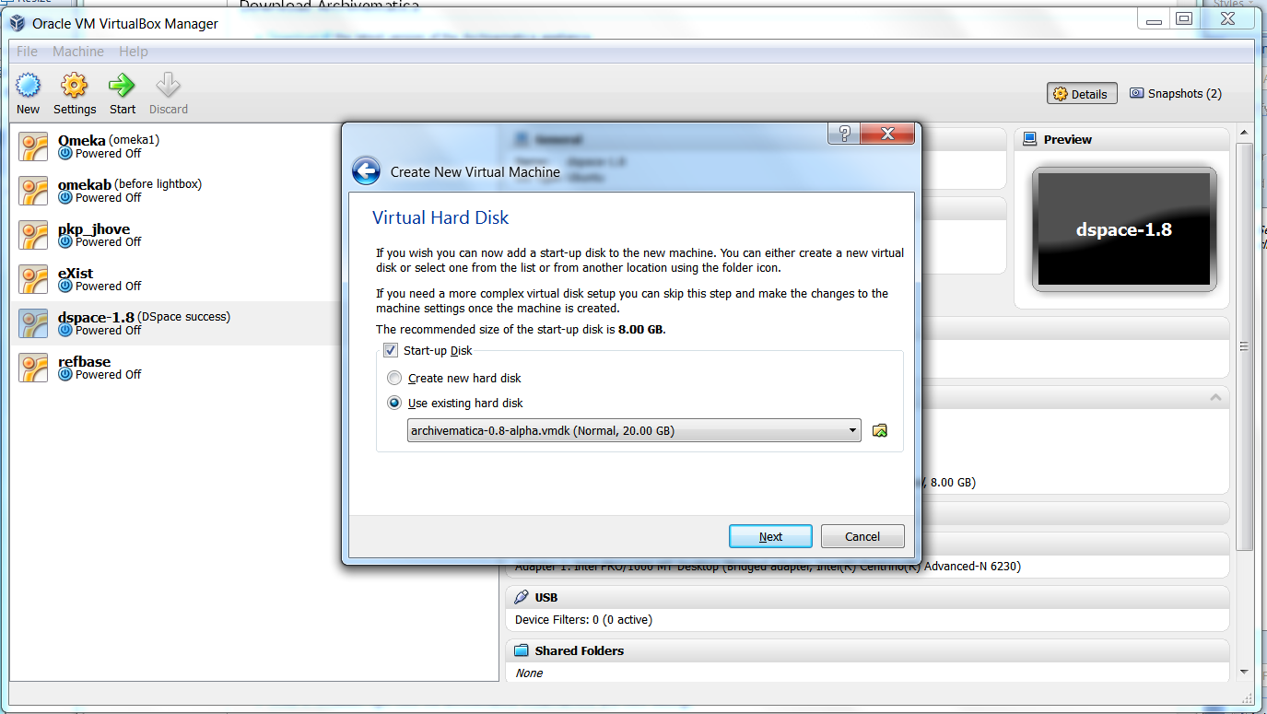
Point to the Archivematica vmdk appliance file

Slide 36
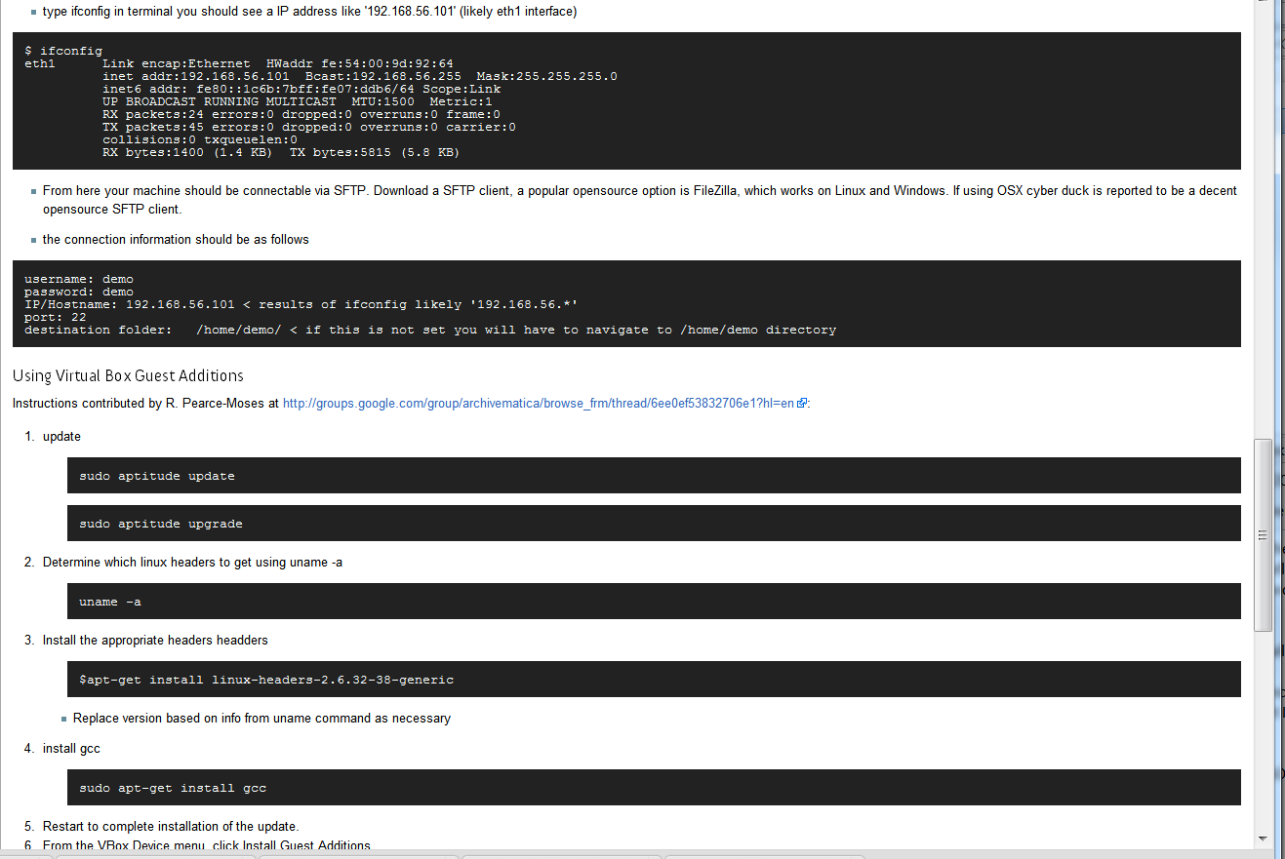
Additional recommended configurations outlined on Archivematica site
Requires some knowledge of Linux command line

Slide 37
List of MicroServices and Tools used by Archivematica
Receive SIP
  verifyChecksum
Review SIP EXT3, Thunar, incron, flock
  extractPackage
  assignIdentifier
  parseManifest
  clean Filename
Quarantine SIP UUID, Detox, Easy Extract, ClamAV
  lockAccess
  virusCheck
Appraise SIP FITS, JHove, DROID, NLNZ Extractor
  identifyFormat
  validateFormat
  extractMetadata
  decidePreservationAction
Prepare AIP FFident, Unoconv, Ffmpeg, OpenOffice
  gatherMetadata
  normalizeFiles
  createPackage
Review AIP ImageMagick, Inkscape, Xena
  decideStorageAction
Store AIP Bagit, SAMBA, NFS-common, Poster
  writePackage
  replicatePackage
  auditfixity
  readPackage
  updatePackage
Provide DIP ICA-AtoM, DCB Dashboard
  uploadPackage
  updateMetadata
Monitor Preservation
  checkFormatRegistry
  migrateFormat
  synchronizeAIPsandDIPs

Slide 38
Live demo of Exercise One in this Archivematica Tutorial: https://www.archivematica.org/mediawiki/images/0/05/Tutorial-08.pdf
Another good introductory tutorial is a YouTube video available on the home page of the Archivematica Wiki:
https://www.archivematica.org/wiki/Main_Page

Slide 39
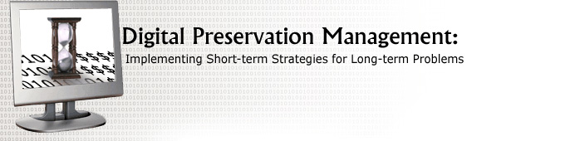
Recommendations:
http://www.dpworkshop.org/
Library of Congress Digital Preservation Outreach & Education (DPOE) http://www.digitalpreservation.gov/education/courses/index.html
DPOE Webinars: Intro to Digital Preservation 1-3 by Jody DeRidder
http://www.aserl.org/archive/
DCC Curation Lifecycle Model: How to use the Curation Lifecycle Model
http://www.dcc.ac.uk/resources/curation-lifecycle-model

