Slide 1
FY12 Open Program LSTA Grant
Statewide Digitization Services
A Feasibility Study

Slide 2
The Details
Any member of Digital Commonwealth is eligible for free scanning at BPL facilities
Site visits and customized metadata consultations
Applicants should consider whole collections (or well-defined sub-units)
  Digitization is limited to up to ~5000 items or 50 bound volumes
  (~15,000 pages)
Currently unable to do audio/video, microfilm/fiche, small format roll film (35mm, etc.)
Digitized items will become accessible via the Digital Commonwealth portal and repository system
Perpetual engagement
Notes:
Main goals of project:
1) To increase the membership base of Digital Commonwealth
2) To increase the number of digital objects and digitized collections available for deposit or harvest into Digital Commonwealth systems.
Massachusetts libraries, museums, archives, historical societies, and other historical organizations are the beneficiaries of the services made available through this grant.
Generally, this project and the activities surrounding it are meant to bolster confidence in this statewide digital library initiative, as well as the confidence of individual institutions in their ability to successfully complete digitization projects.
As DC systems, policies, governance, and business models are developed over the next several years, the BPL expects to contribute the products of this grant project to a robust and sustainable digital repository and library system for the Commonwealth of Massachusetts.
**Initially announced on various email lists (MLS, NEA, ARLIS NE-L, NEMA) between mid-August and late-September 2011 and the Digital Commonwealth officially announced the program in late September 2011. Digitization through the grant initiative began October 1, 2011

Slide 3
Want To Know More?
Announcement from Digital Commonwealth:
http://www.digitalcommonwealth.org/doc/announcement/
Application form:
http://bit.ly/dcbplform

Slide 4
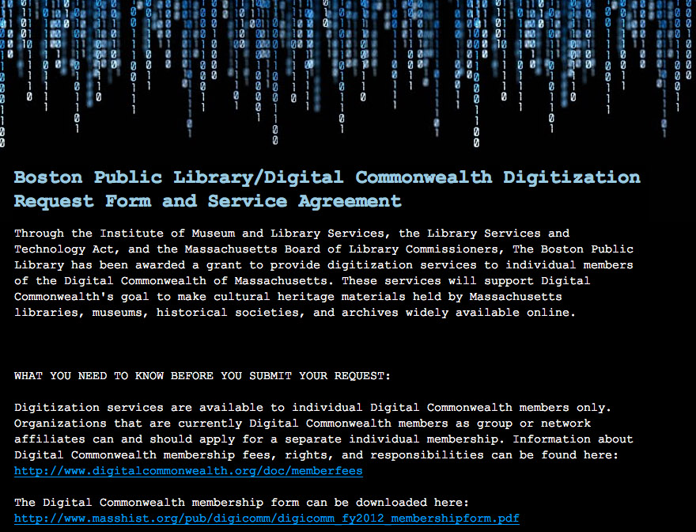
Notes:
Project Activities/Methods:
Review submissions made via the online form. Follow up with each applicant by email or phone within ten business days of submission to confirm receipt of application.
Contact applicants to arrange consultative site visits as well as delivery and return of materials and to discuss the specific requirements and limitations of each project.
Conduct site visits to partner institutions using LSTA funds for car rental. Evaluate materials and make recommendations to partners concerning selection, descriptive-metadata creation, and preparation of items for digitization (e.g., removal from some types of enclosures, unique identification system clearly expressed, duplicate review and removal, etc.).
Make arrangements for transportation of items to and from BPL facilities for digitization using either LSTA-funded rental car or delivery service, or allow partner institution to deliver on their own.
Schedule digitization production in BPL labs based on quantity of items, physical characteristics of collections, and level of imaging equipment availability. Receive materials upon arrival at BPL, record information into materials-received spreadsheet, and fill out internal tracking forms.
Digitize non-bound materials and perform post production tasks (e.g., cropping, rotating, and image adjustments for contrast and color). Create derivative image files as required by partner institutions. Transfer master files to BPL storage system. Transfer master files, and any derivative files, to portable hard drive or CD/DVD for delivery to partner institutions.
Prepare bound items for Internet Archive digitization workstream. Crosswalk data from partner institutions’ descriptive metadata records into Internet Archive digitization template. For a few small partner institutions (those without on-staff catalogers or librarians), create original descriptive information to be used by the Internet Archive. Following digitization, prepare and send book delivery URLs to the partner institution to facilitate discovery of resources on a local website or integrated library system.
Record application and production statistics in order to support constant engagement with partners as the DC portal and repository system is developed and becomes more capable of supporting a variety of digital object types.
Create blog postings to be shared on the project website or other related websites (e.g., the BPL “Compass” blog — http://www.bpl.org/compass — the BPL’s website for strategic planning).

Slide 5
The Applicants
Thomas Crane Public Library
(Quincy)
East Bridgewater High School
West Bridgewater Public Library
Jamaica Plain Historical Society
Massachusetts Historical Society
Cape Cod Community College
Clark Art Institute
UMASS-Lowell
Children’s Hospital Archives
Faulkner Hospital
State Library of Massachusetts
Roxbury Latin School
Chelmsford Public Library
Perkins School for the Blind
Gleason Public Library (Carlisle)
Andover Newton Theological
Fiske Public Library (Wrentham)
Holmes Public Library (Halifax)
Griffin Museum of Photography (Winchester)
North Adams Public Library
Watertown Free Public Library
Norwood High School
Jacob Edwards Library
(Southbridge)
Boston Public Library
Bridgewater State University
Melrose High School
Mt. Wachusett Community College
Lucius Beebe Memorial Library
(Wakefield)
Lunenburg Historical Society
Newton Free Library
Sturgis Library
Carver Public Library
Worcester Polytechnic Institute
Lasell College (Auburndale)
Westfield State University
Brandeis University
Springfield College
New Bedford Free Public Library
Chapter 9 of the 173rd Airborne Brigade Association
Wilbraham Public Library
Kingston Public Library
Simmons College Archives
Northeastern University Libraries
Waltham Public Library
Stoneham Public Library
Bushnell-Sage Library
(Sheffield)
Worcester Public Library
Auburn Free Public Library
Lee Library Association
Wilmington Memorial Library
Countway Library of Medicine
Cambridge Public Library
Fitchburg Public Library
Somerville Public Library
Episcopal Divinity School (Cambridge)
Mattapoisett Free Public Library
Notes:
Digitization Applicants through March 31, 2012.
We continue to receive applications and we’ve created a queue for FY 2013, which would begin in October 2012 if the BPL receives funding. Some of the applicants shown are already in the queue for next year.
Additional applicants are:
Westborough High School Library
Salem State University
Hingham Public Library
Swampscott Public Library
Holyoke Public Library
Framingham Public Library
The Lenox Library

Slide 6
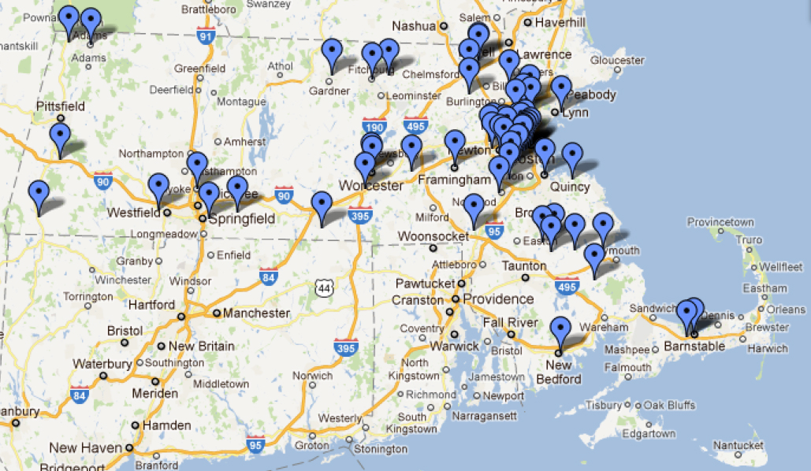
http://bit.ly/dcbplmap
Notes:
Beginning January 2012, an intern from Emerson College was brought on as a project liaison. Her responsibilities include direct solicitation of applications from institutions located in currently under-represented areas of the state (e.g., the Pioneer Valley, Cape Ann). So far, only one applicant (New Bedford Public Library) applied after being directly solicited. The other institutions responded as a result of indirect bulk outreach.
Legislative support:
The Boston Public Library has proposed that the activities and goals of this project be part of its Library for the Commonwealth program. Through various channels, the BPL is actively lobbying the Massachusetts Legislature for statutory funding in order to fully support the goals of this program.
Some legislators have already indicated their support for this initiative publicly. They are:
Rep. William C. Galvin
Rep. Kate Hogan
Rep. Mary Walz
Rep. Byron Rushing
Rep. Christine Canavan
Rep. Paul McMurtry
On March 21, the BPL hosted a legislative breakfast where several state senators and representatives were in attendance. During this breakfast, Debra Dejonker-Berry (Holmes Public Library) and Carrie Tucker (East Bridgewater High School Library) spoke to the audience about their satisfaction with the free-digitization project. Letters are currently being drafted to send to project applicants urging them to contact their elected officials regarding further support for the project.

Slide 7
October 1, 2011 – March 31, 2012
56 Institutions Apply for Digitization Services
Notes:
56 different institutions have applied for free digitization under this grant.
Thus far, only one applicant (New Bedford Public Library) applied after being directly solicited. The other institutions responded as a result of indirect bulk outreach. This seems to indicate that there was a preponderance of pre-existing potential projects.
The applicants fall into the following categories:
Public: 27 (48%)
College: 13 (23%)
School: 6 (11%)
Historical societies: 4 (7%)
Special: 4 (7%)
Museums: 2 (4%)
The initial goal of the grant was to increase DC membership from 37 to 200 over two years. As a one-year project, we sought to recruit between 40 and 80 new DC members. We are on pace to accomplish this.

Slide 8
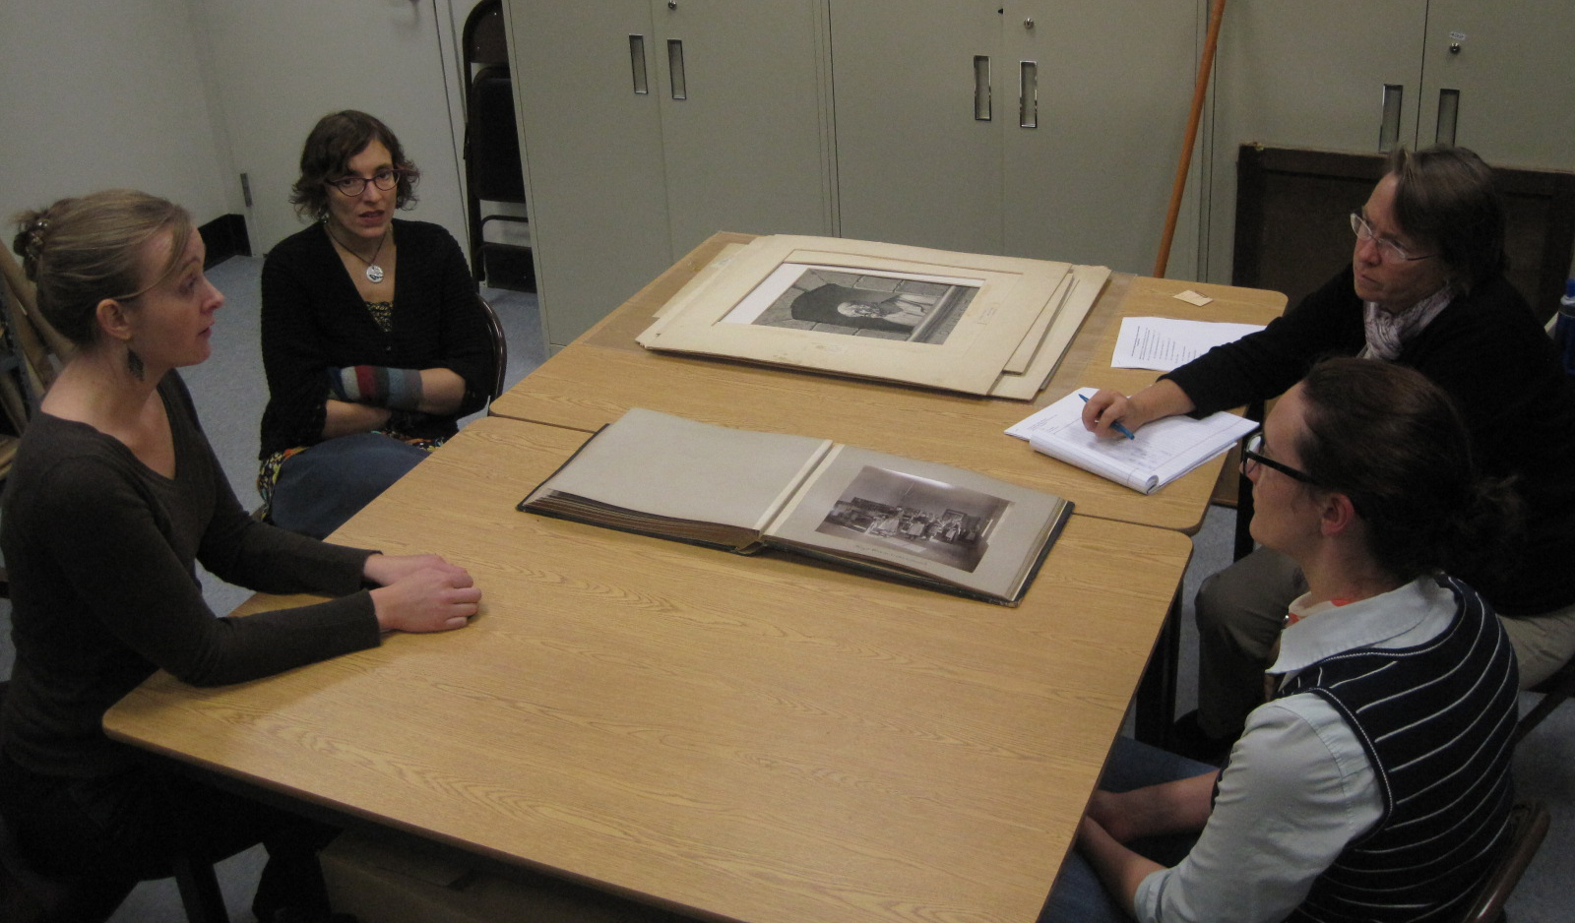
Site Visits and Consultations
- Metadata Roadside Assistance -
Notes:
***Danny and Chrissy discuss image description with Molly Stothert-Maurer and Charlotte Cushman of Perkins School for the Blind.
We’re calling this a “challenge grant” – Boston Public Library provides the digital images but the partner institution is required to provide the descriptive metadata to make the items findable in the Digital Commonwealth portal and repository system.
If they have bound materials and a MARC record, they’re ready for digitization. These folks generally do not receive site visits.
If they are submitting non-bound unique items (such as photographs or maps), they need to provide data for each item. Our consultations general revolve around discussion of how such description can be accomplished (content standards, controlled vocabularies, etc.).
If the institution has applied to have non-bound unique items digitized, it receives a site visit. In many ways, the site visits and individual consultations have been the most interesting and rewarding aspects of this grant project.
Individual institutions have their own particular capacity and tendencies for storing, describing, and preparing their materials for digitization.
Each collection has required a slightly (or grossly) different approach to digitization as far as:
Physical-handling aspect of the workflow
Creation and distillation of descriptive metadata from whatever happens to be available on cards, in captions, or within a staff member’s institutional memory.

Slide 9
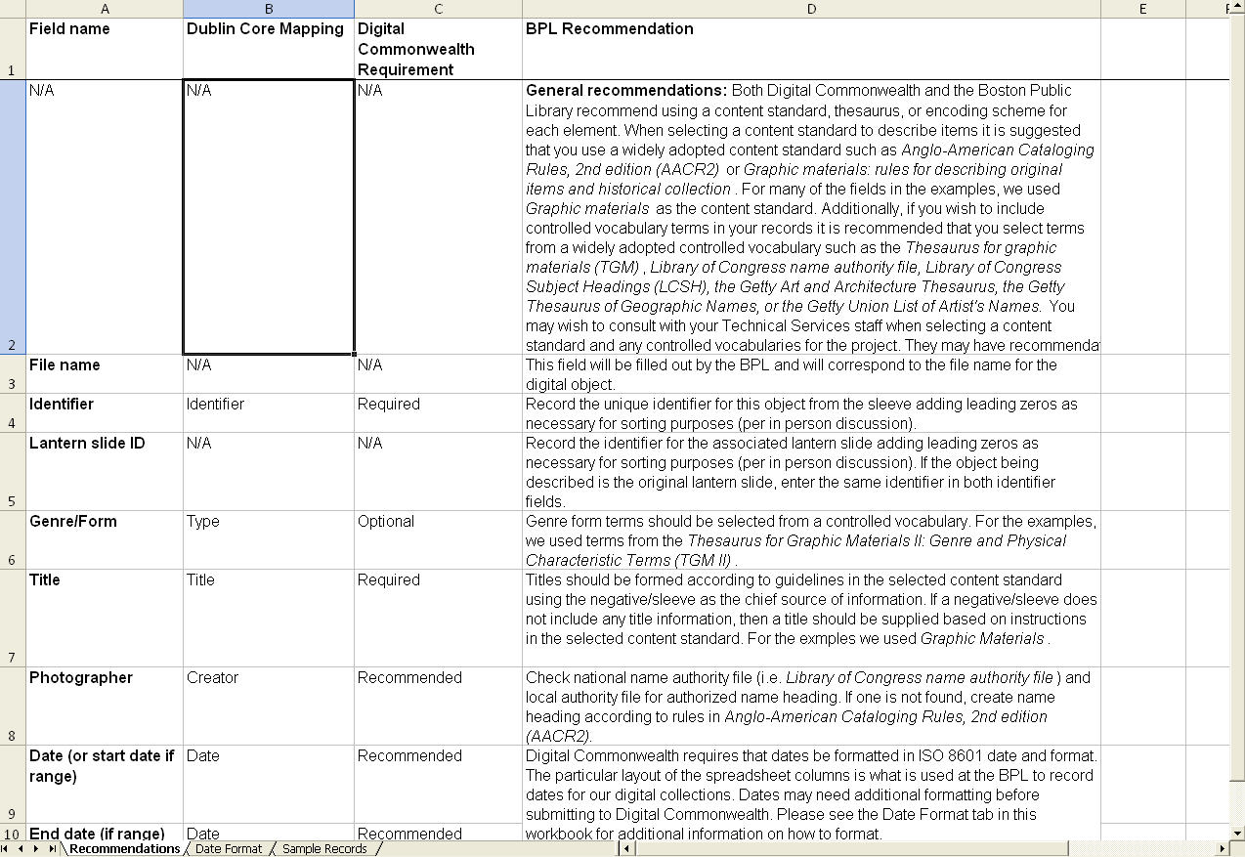
Notes:
Of the 56 applicants, 19 have received evaluative and consultative site visits from BPL staff.
Digitization process discussed
Materials evaluated for digitization readiness (e.g., need to be dis-bound? Rehoused?)
Metadata requirements and strategies were crafted.
Several institutions required further consultations beyond the initial site visit to help prepare them for their descriptive metadata processes. Further guidance provided via:
Email
Phone
In-person at the BPL by BPL staff
Currently the Digital Commonwealth repository requires only:
Unique identifier
Title
But additions such as creator or subject will make each item more findable.

Slide 10
BPL Digital Imaging Lab
High-end digital cameras and flatbed scanners can accommodate a wide variety of material formats and sizes
Digitization in compliant with:
  Federal Agencies Digitization Guidelines Initiative (FADGI)
  ISO 3664:2009
Notes:
There are currently two digitization facilities at the Boston Public Library: The library’s own digital imaging lab and the Internet Archive.
The digital imaging lab is optimized to digitize materials of most any size or dimension. This is where we digitize the:
Leventhal Center maps
photographic prints
large-format glass and film negatives
postcards
posters
manuscripts
lantern slides
atlas pages
All imaging is done in accordance with the Federal Agencies Digitization Guidelines Initiative's "Technical Guidelines for Digitizing Cultural Heritage Materials" (http://www.digitizationguidelines.gov/).
Our studio environment is ISO 3664:2009 compliant (http://www.iso.org/iso/catalogue_detail?csnumber=43234).
Walls are Munsell N7 gray and light box is D50 light quality (daylight) balanced for optimal viewing.
We use high-end digital cameras manufactured by Sinar for most of our imaging procedures and produce TIFF master files with an embedded Adobe RGB profile at 16 and/or 8 bit. We will also provide any JPEG derivatives needed by the partner institution at a size and compression ratio of its choosing.
We are prepared to store a copy of the master files on our own servers until the Digital Commonwealth repository system is equipped to manage such digital objects on their own.

Slide 11
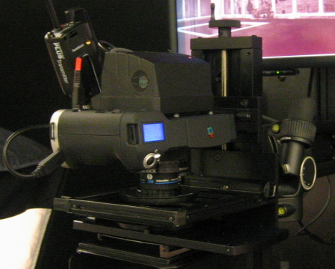
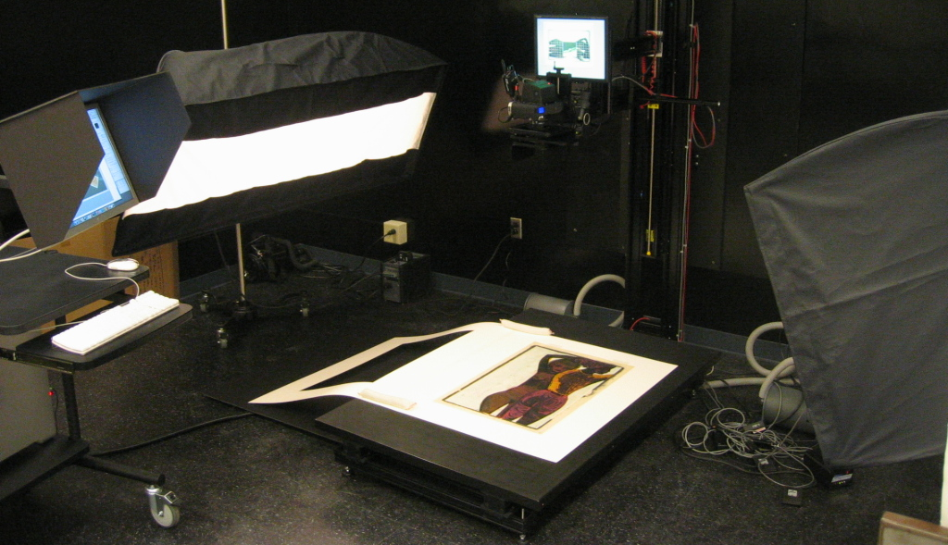

Slide 12
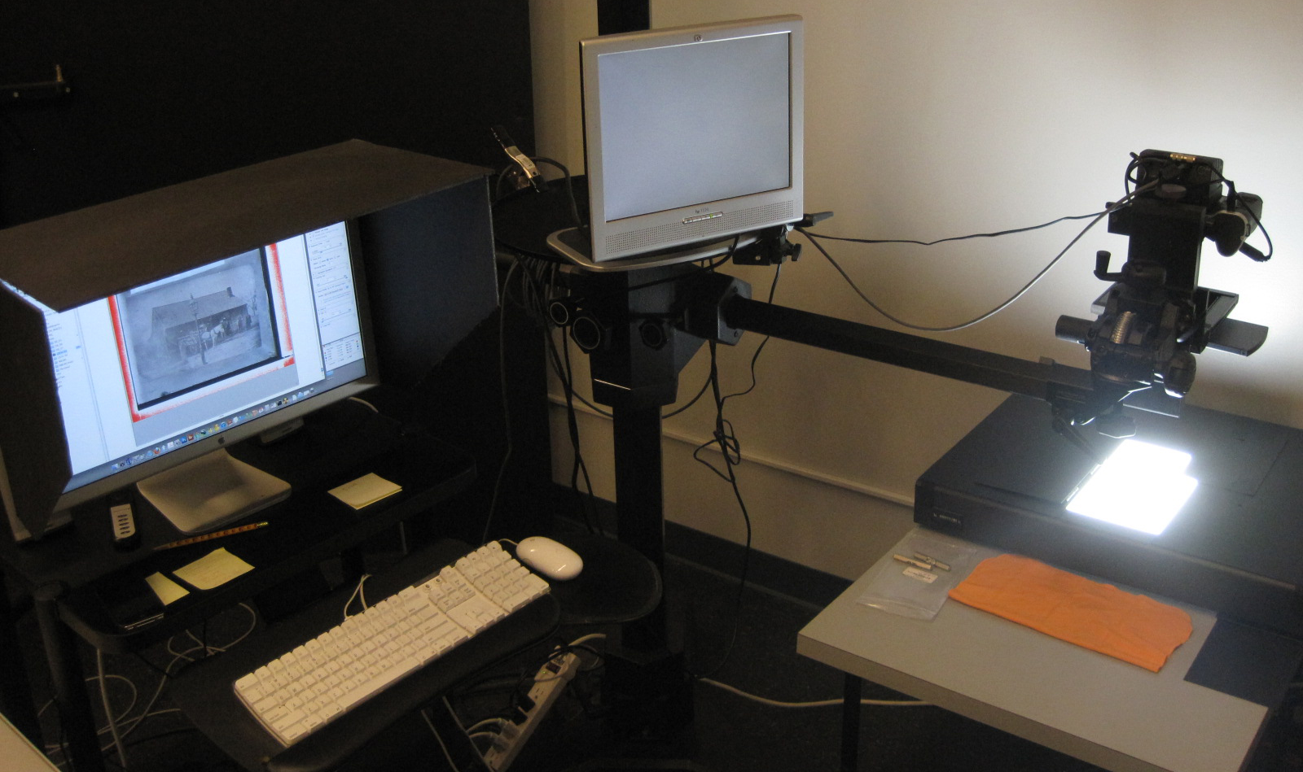

Slide 13
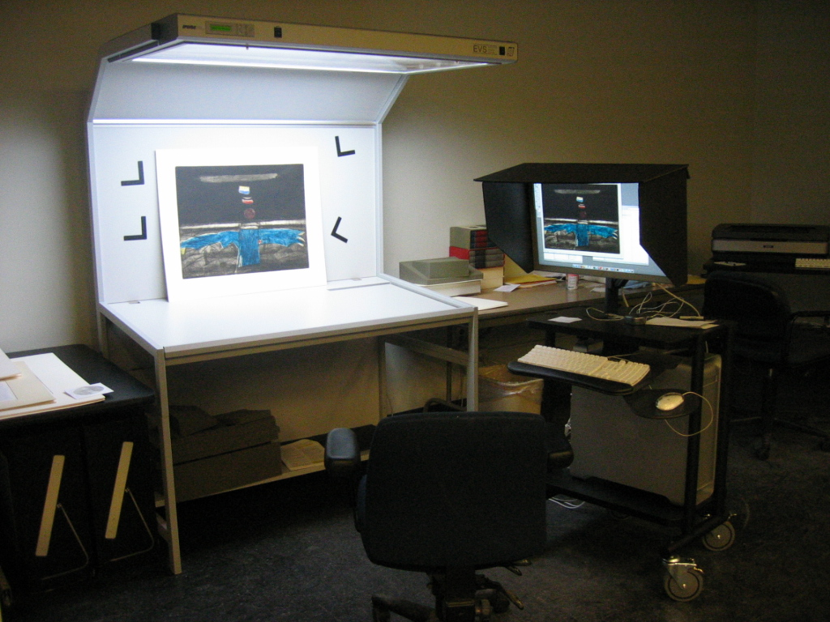

Slide 14
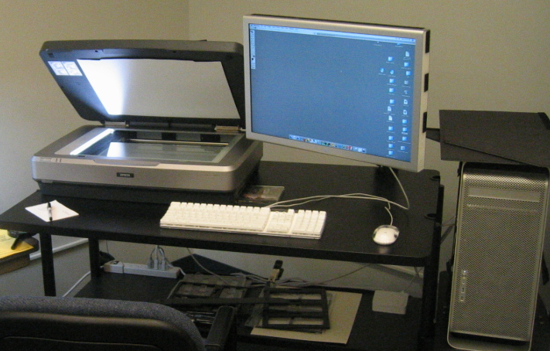

Slide 15
Internet Archive - www.archive.org
Internet Archive “scribe” stations used for digitizing bound materials
Digitization includes imaging, OCR, derivative (PDF, ePUB, DAISY, etc.), online display and storage.
All available for download
Notes:
The second digitization facility at the BPL is operated by the Internet Archive, a non-profit 501(3)(c) based in San Francisco. Their lab is optimized for digitizing, processing, and delivering bound materials. They use Canon 5D cameras mounted over a 110-degree V-shaped book cradle and their digitization specs are more in line with those designed for text conversion from image-based to machine-readable formats. The Internet Archive has a scan center here in the BPL (across the hall from our own digital lab) and we have been working very closely with them for about 6 years.
Once books are digitized by the Internet Archive, they become available in a variety of formats (PDF, DAISY, ePUB, Kindle, etc.) and can be viewed online through the Internet Archive’s own book viewer. Additionally, any institution that submits books will have access the master files by following the "All Files: HTTP" link to a directory listing of the original JPEG2000 image files, as well as the raw OCR and descriptive metadata files (in XML).
Digitization: Digitized at the Boston Public Library and federally funded with LSTA funds through the Massachusetts Board of Library Commissioners.
Book contributor: The partner institution.

Slide 16
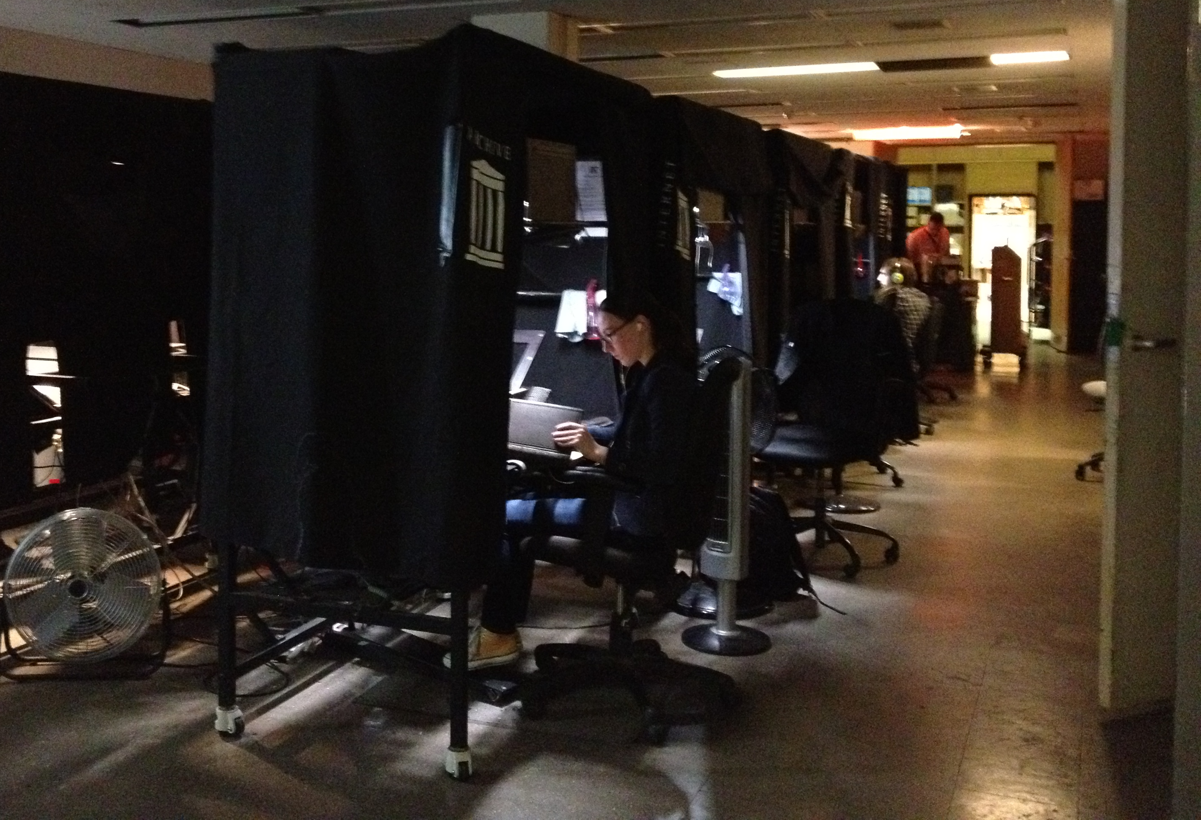

Slide 17
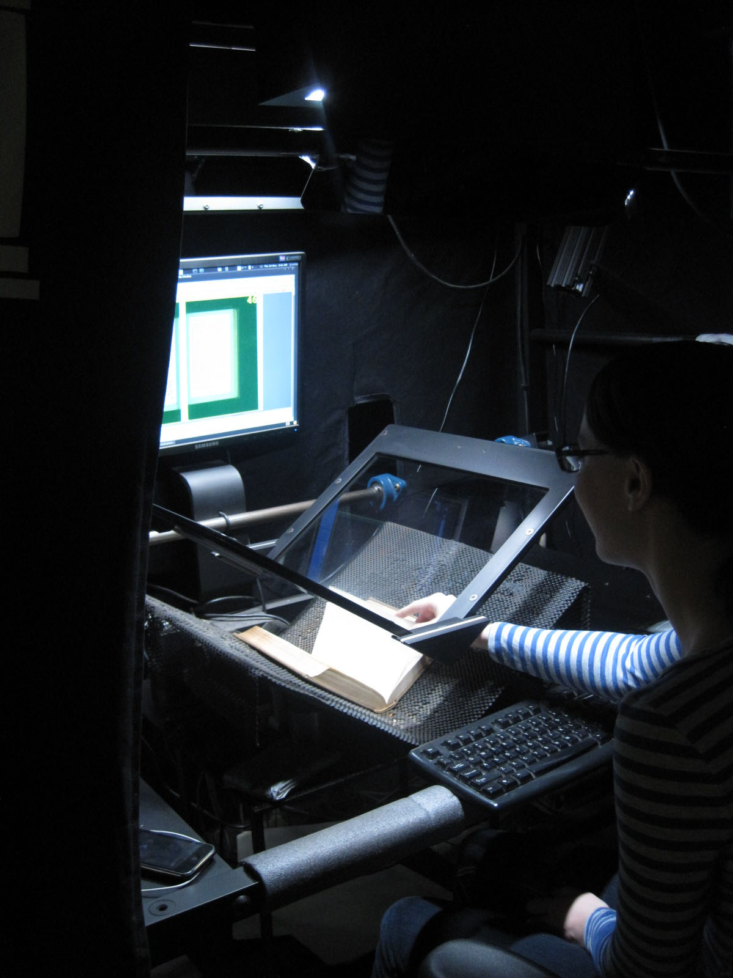

Slide 18
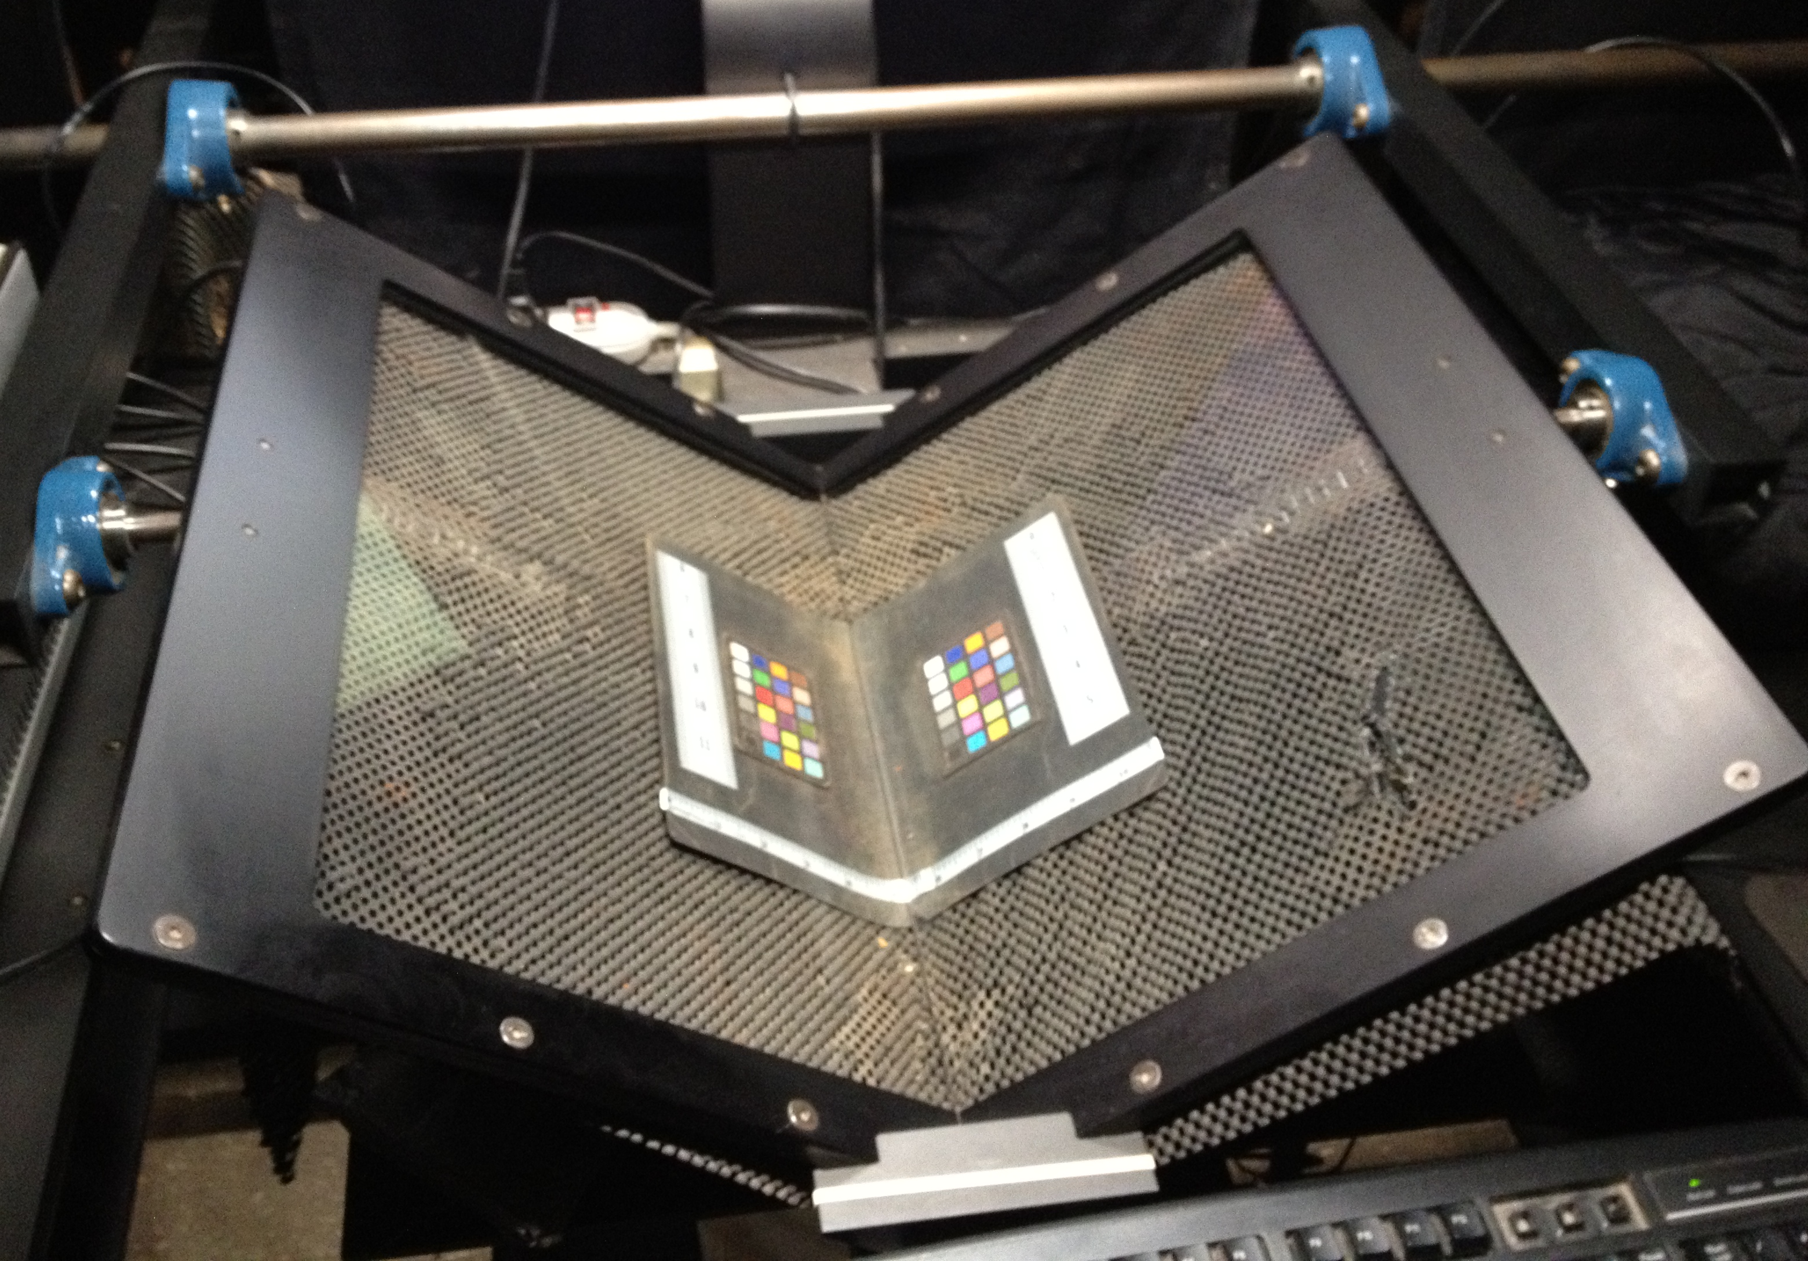

Slide 19
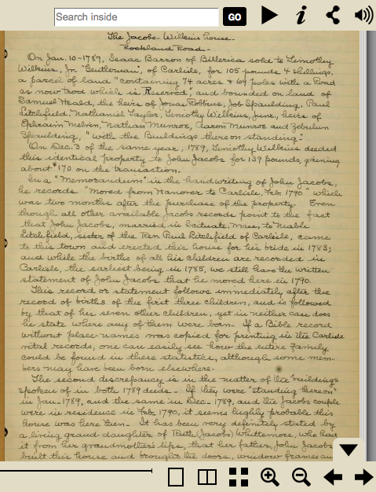
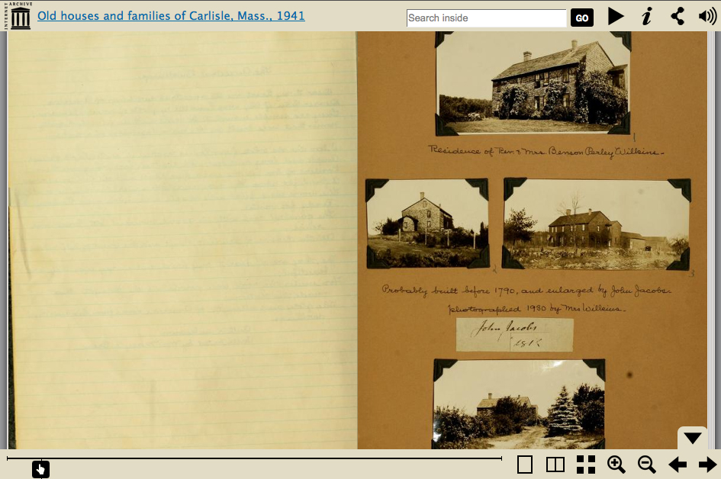
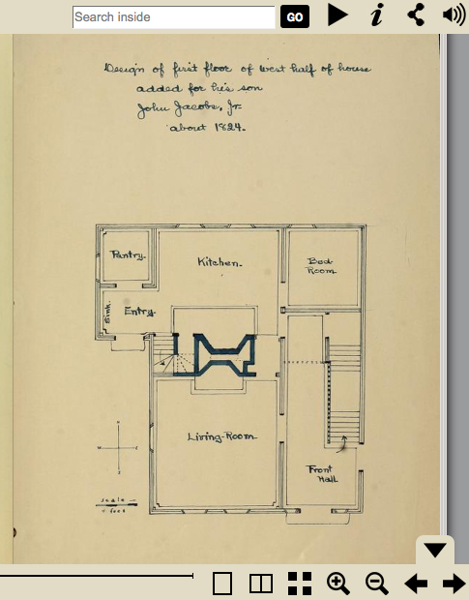
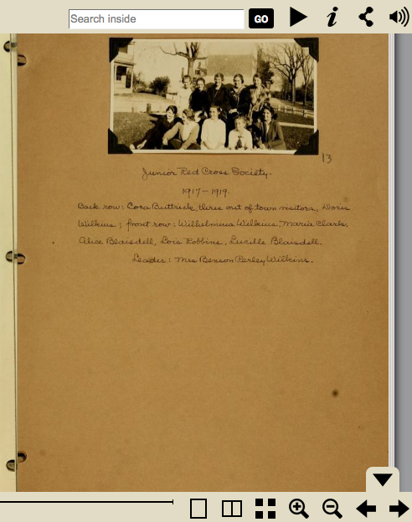
Gleason Public Library
Notes:
Here is an example of how digitization at the BPL digital imaging lab and the Internet Archive can intersect.
In this case, the Gleason Public Library wanted to digitize its “Wilkins Notebooks” collection. This is a collection of notebooks created by Martha Fifield Wilkins of old houses and families in Carlisle, MA and includes both handwritten material and photographs.
In order to preserve each volume as a complete unit, we digitized the notebooks at the Internet Archive, where they can be viewed in their entirety as 2-page spreads.
In addition, we removed the photographs from the binders and created hi-resolution archival TIF files for each item.
As far as file delivery, Gleason received both the Internet Archive materials as well as the hi-res TIFs and they are free to use them in any way they would like at their institution or on their website.

Slide 20
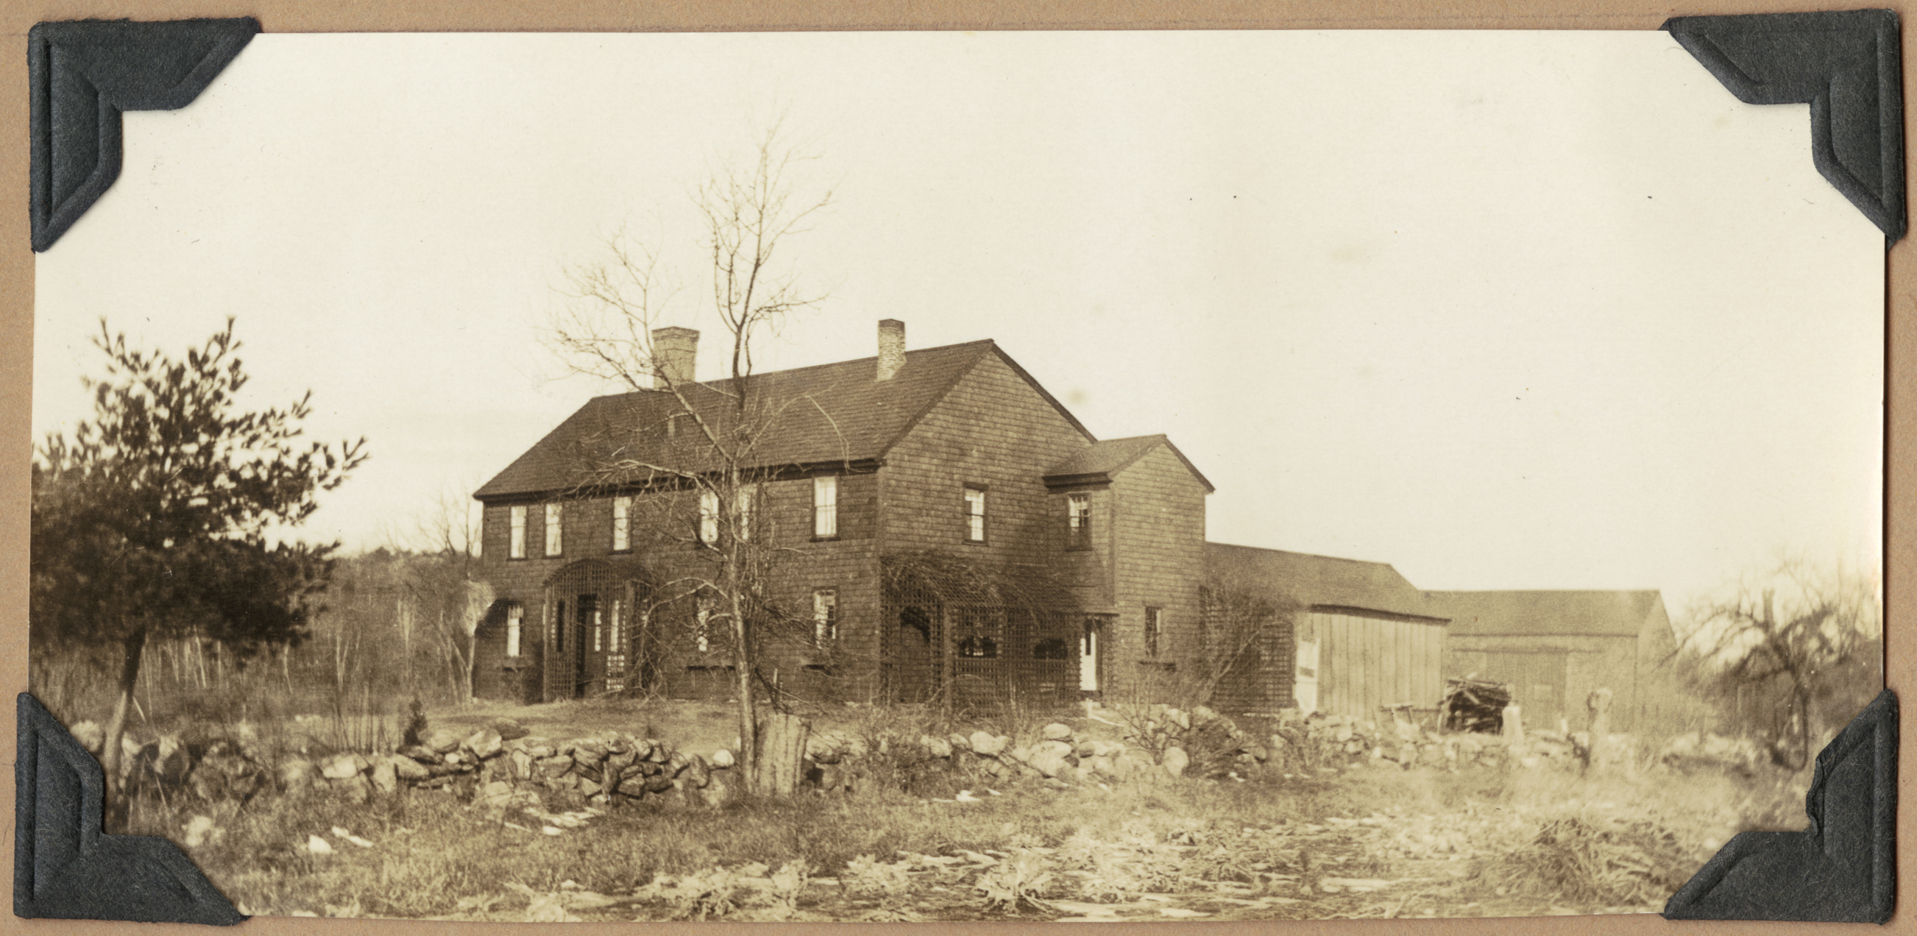
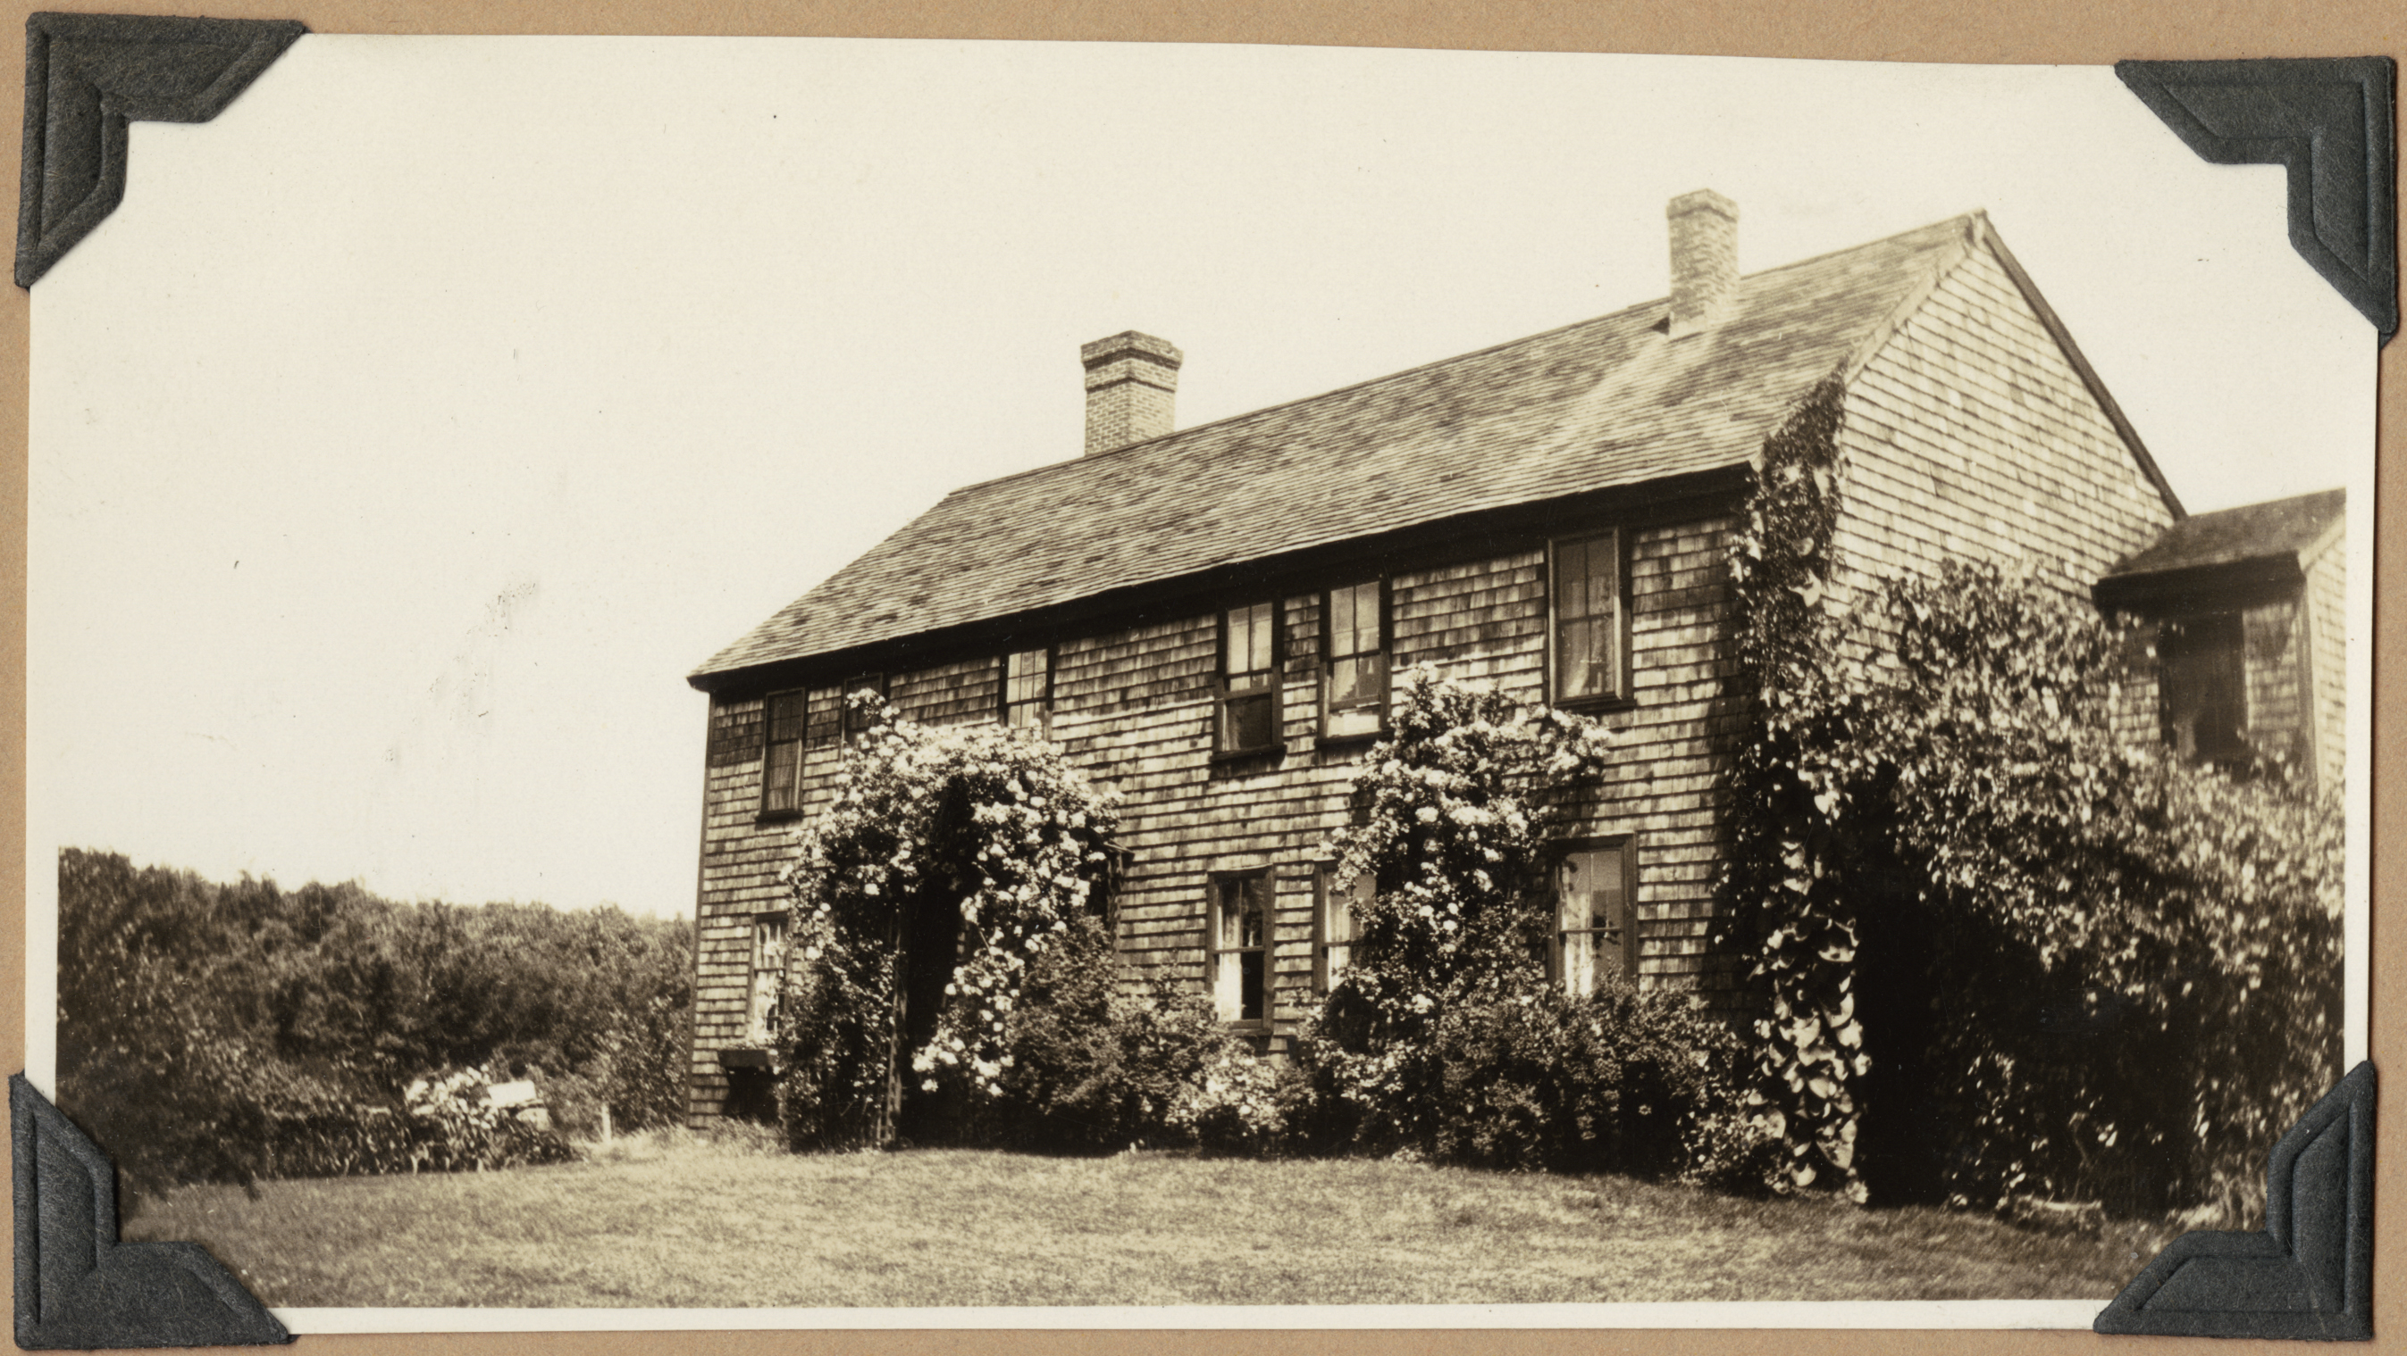
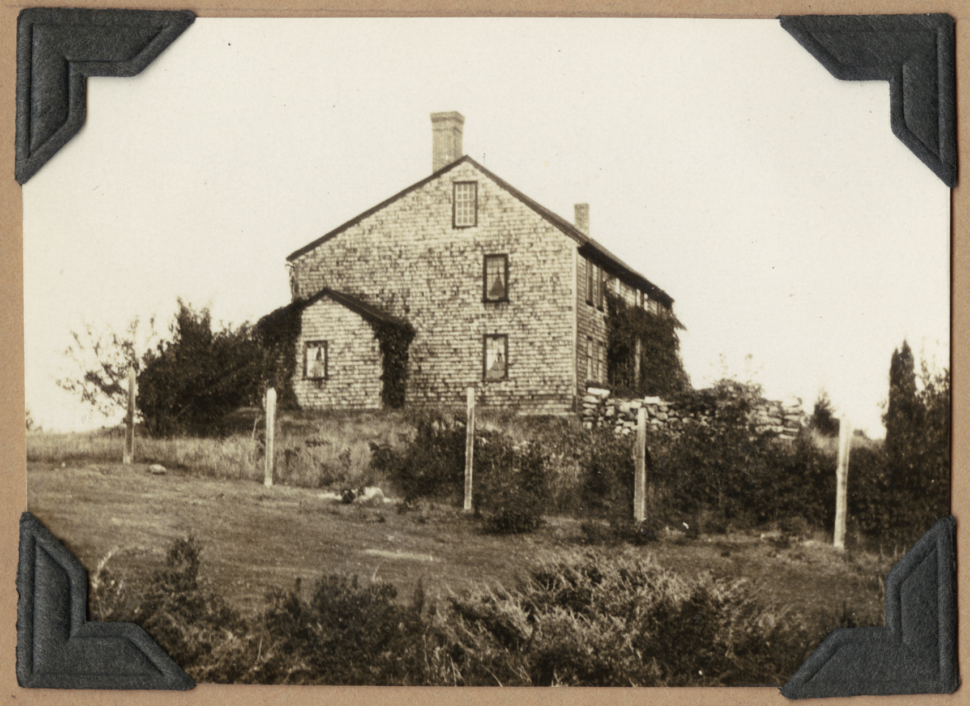
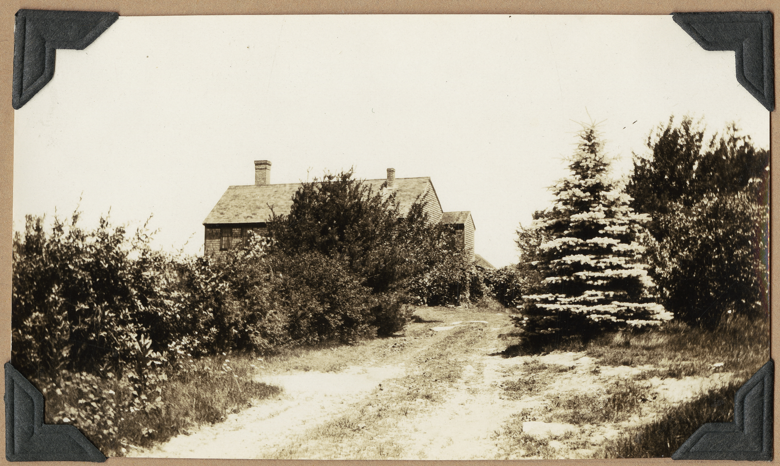
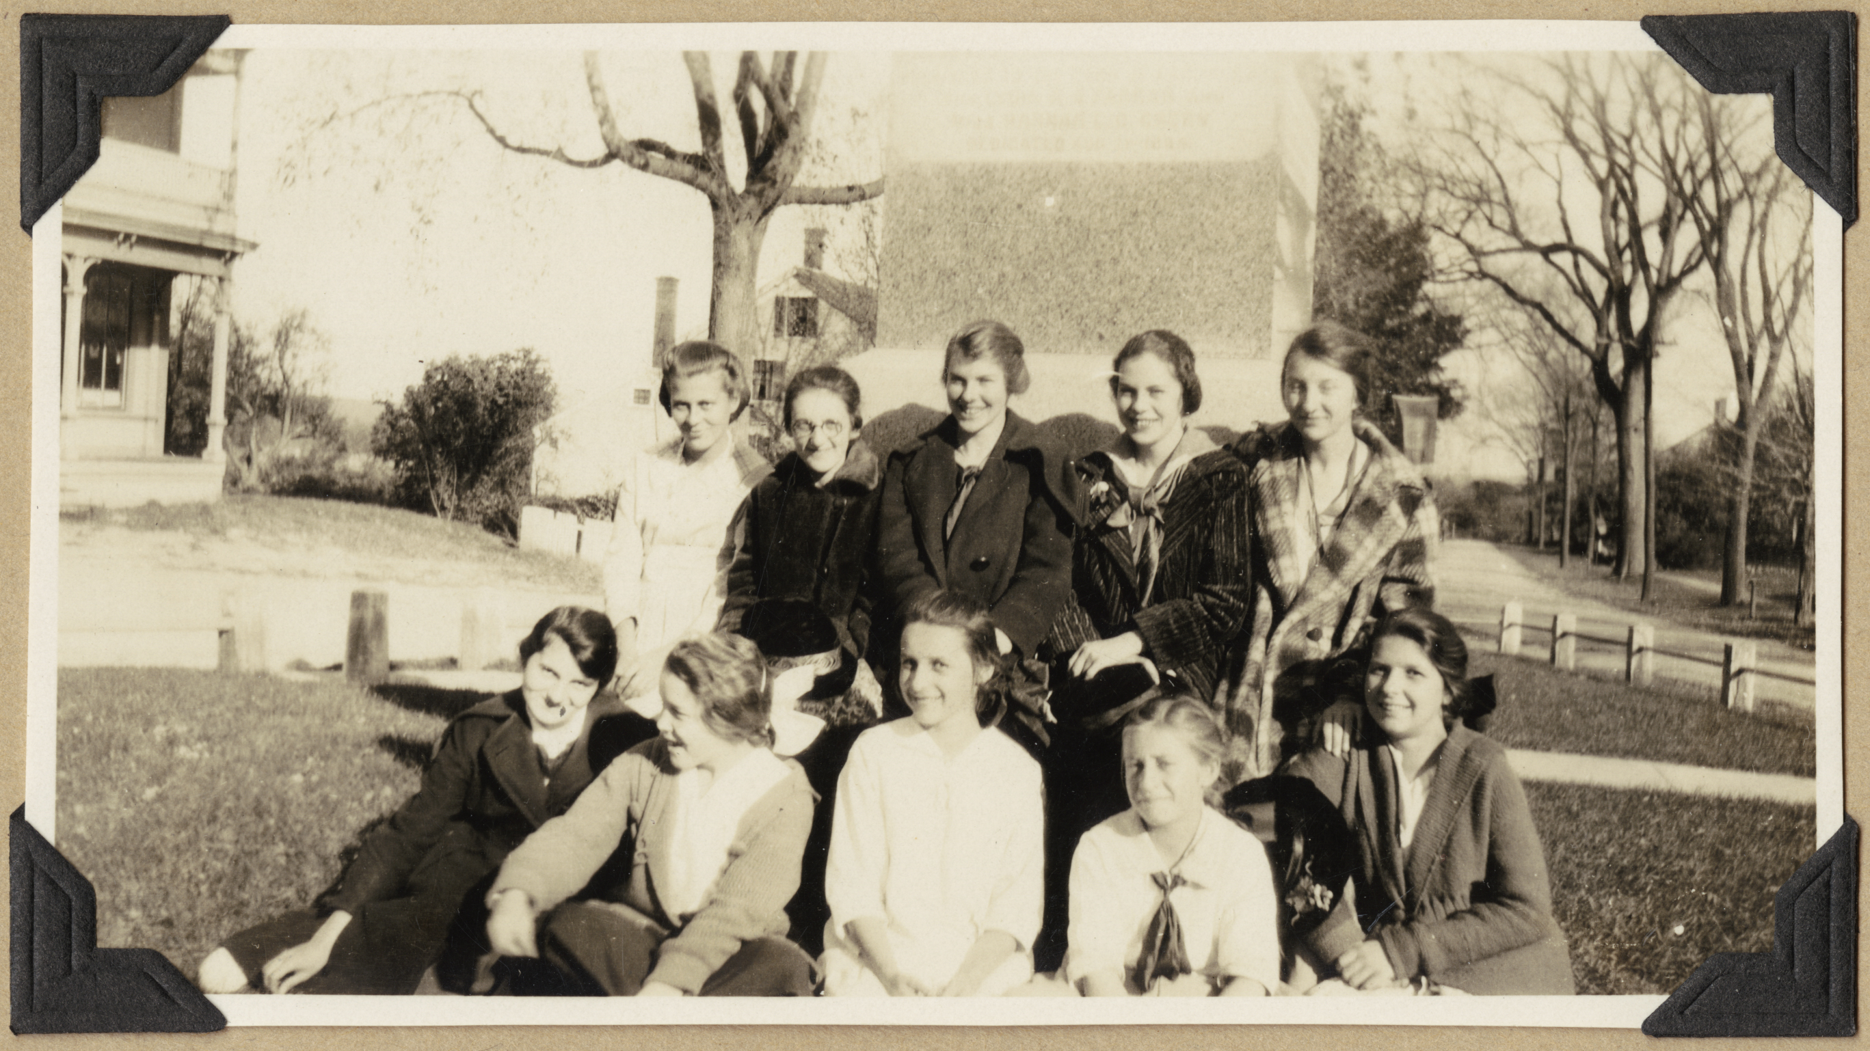
Gleason Public Library

Slide 21
BPL Digital Imaging Lab
- Breakdown of Materials -
Notes:
As of March 31, 11,384 individual objects have been digitized at the BPL digital imaging lab. Digitization is ongoing, so more since then.

Slide 22
Materials include…
Thomas Crane Public Library – Warren S. Parker photos
  Collection of Quincy properties and landscapes
Perkins School for the Blind – Blind in Art collection
  Prints, lithographs
UMASS-Lowell – Historic atlases
Cape Cod Community College – Babbitt Collection
  Historic deeds
North Adams Public Library – Hoosac Tunnel collection
  Photos, engineering drawings, postcards, books
Carver Public Library – Cranberry labels
Massachusetts State Library – Historic photos
  Members of the Massachusetts legislature
Lucius Beebe Memorial Library – Oversize maps

Slide 23
Internet Archive
- Breakdown of Materials -
Notes:
As of March 31, 893 individual volumes (155,259 pages) have been digitized at the BPL’s Internet Archive scanning center. Again, digitization is ongoing, so more since then.
These books have been downloaded 4,090 times via the Internet Archive.
The demand for and rate of production through the BPL’s Internet Archive lab was higher than anticipated in FY 2012. If awarded, the grant for FY2013 increases this budget line significantly to meet demand in this area.

Slide 24
Yearbooks!!!
East Bridgewater High
School Library
Melrose High School Library
West Bridgewater Public
Library
Holmes Public Library
(Halifax)
Chapter 9 of the 173rd
Airborne Brigade Association
Jamaica Plain Historical
Society
Norwood High School Library
Jacob Edwards Library (Southbridge)
Mt. Wachusett Community College
Bridgewater State University
Worcester Polytechnic Institute
Westfield State University
Wilbraham Public Library
Simmons College Archives

Slide 25
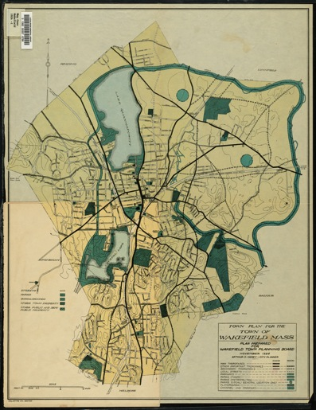
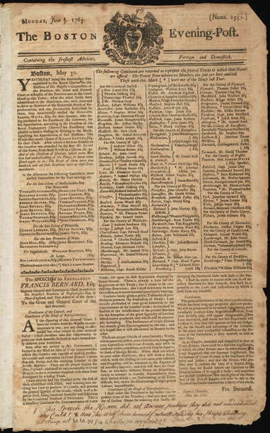
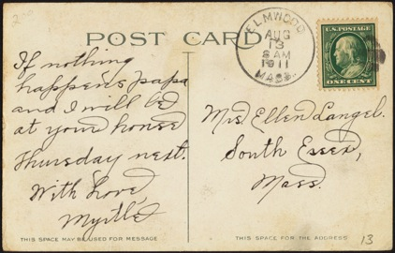
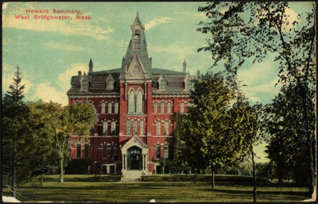
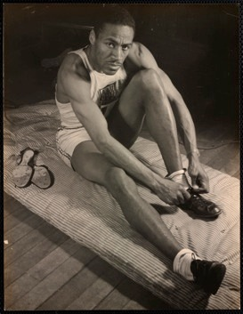
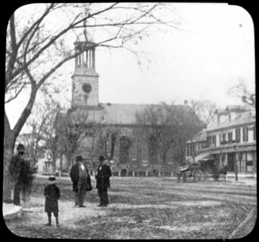
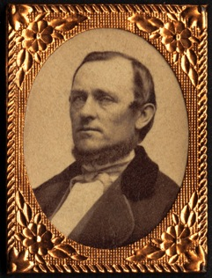
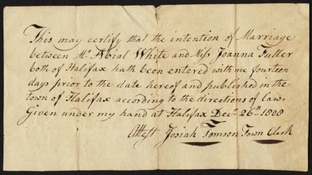
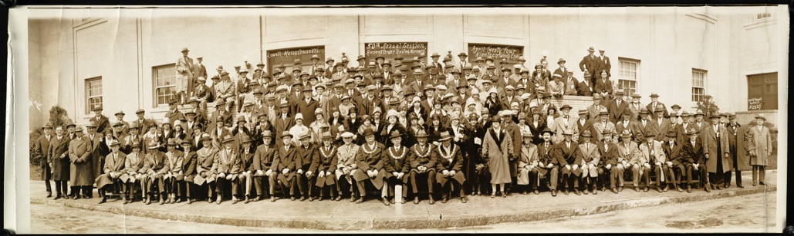
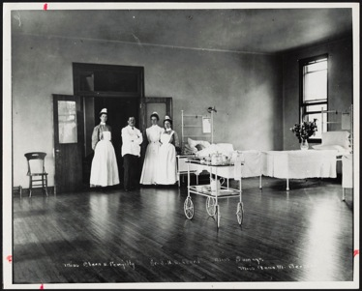
Some examples…
Notes:
West Bridgewater / Postcard w/handwritten note on back / Howard Seminary, W. Bridgewater, MA
Faulkner Hospital medical staff
State Library of Massachusetts / Photographs of members of the Massachusetts legislature
Thomas Crane Public Library / Warren S. Parker photograph collection / Parker held the position of city building inspector and created these glass slides to illustrate a series of lectures about Quincy history.
Lowell Historical Society / George Russell Photograph Collection (panoramic photographs) / 50th Annual Session, Ancient Order of United Workmen, April 24, 1928, Lowell, MA
Griffin Museum of Photography / image from the Arthur Griffin Archives (photojournalist for Boston Globe, Archives holds photos, negatives, newspaper clippings)
Lucius Beebe Memorial Library / Maps – Town plan for the town of Wakefield Mass., plan prepared for Wakefield Town Planning Board, November 1924 (Arthur C. Comey, City Planner)
Massachusetts Historical Society / Annotated newspapers by Harbottle Dorr / Boston Evening-Post, Monday, June 3, 1765 / Numb. 1552 – (About "The Speech of his Excellency Francis Bernard, Esq – Captain-General and Governor in Chief, in and over His Majesty's Province of Massachusetts-Bay, in New England, and Vice-Admiral of the same; To the Great and General Court of the said Province")
Annotated with – “This speech the House did not answer, perhaps they did not understand. Who could? * Now the wolf shows himself notwithstanding his sheep's clothing.”
Holmes Public Library / Halifax Congregational Church marriage intentions – “This may certify that the intention of Marriage between Mr. Abial White and Miss Joanna Fuller both of the Halifax bath been entered with me fourteen days prior to the date hereof and published in the town of Halifax according to the directions of law. Given under my hand at Halifax, Dec. 26th 1808. Josiah Tomson Town Clerk”

Slide 26
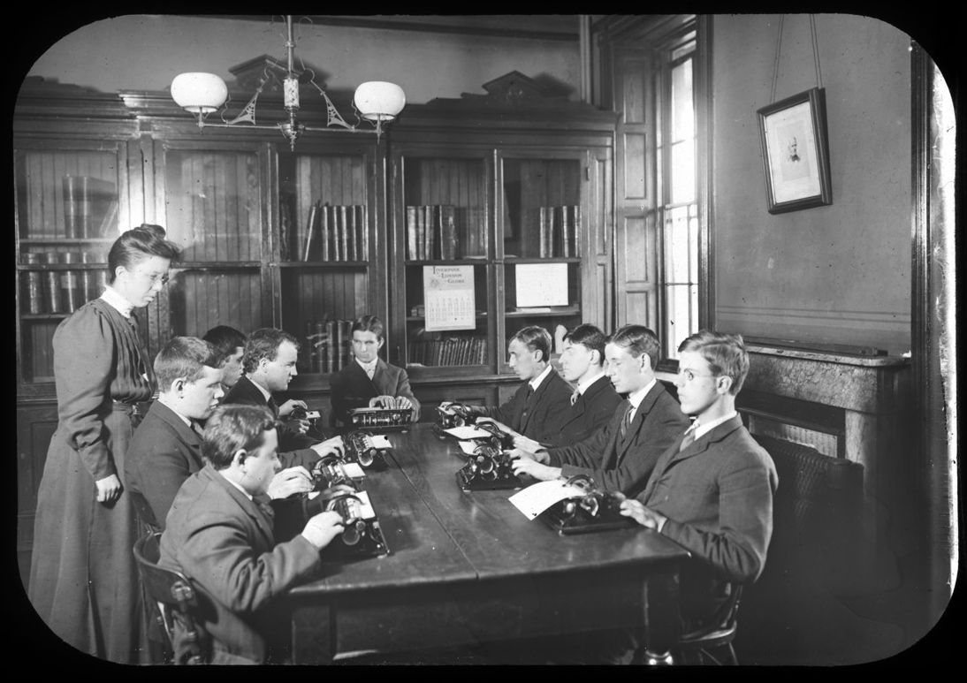
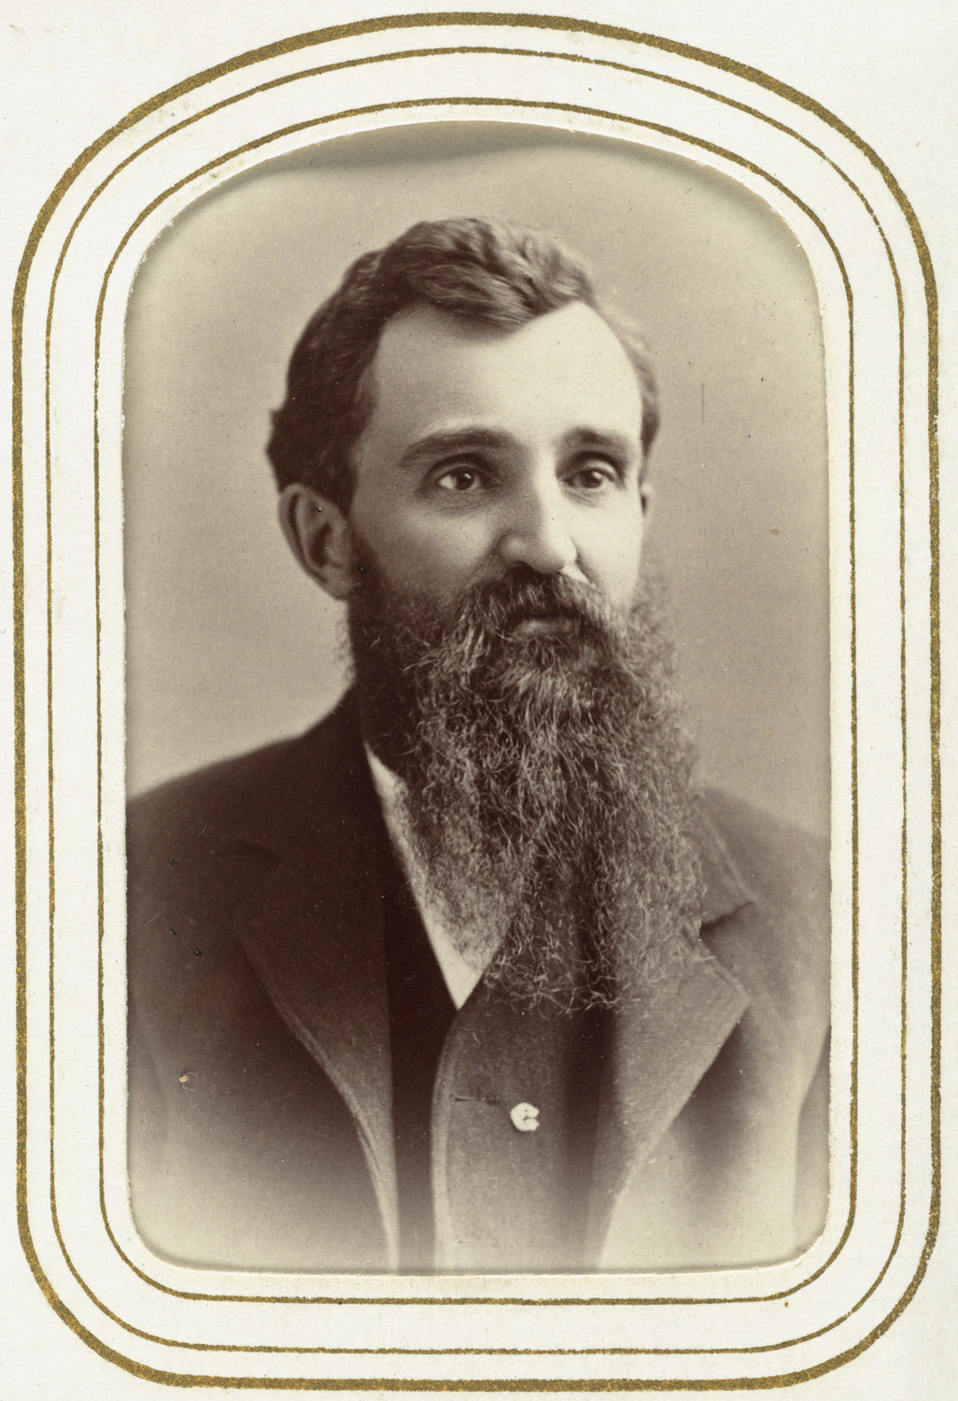
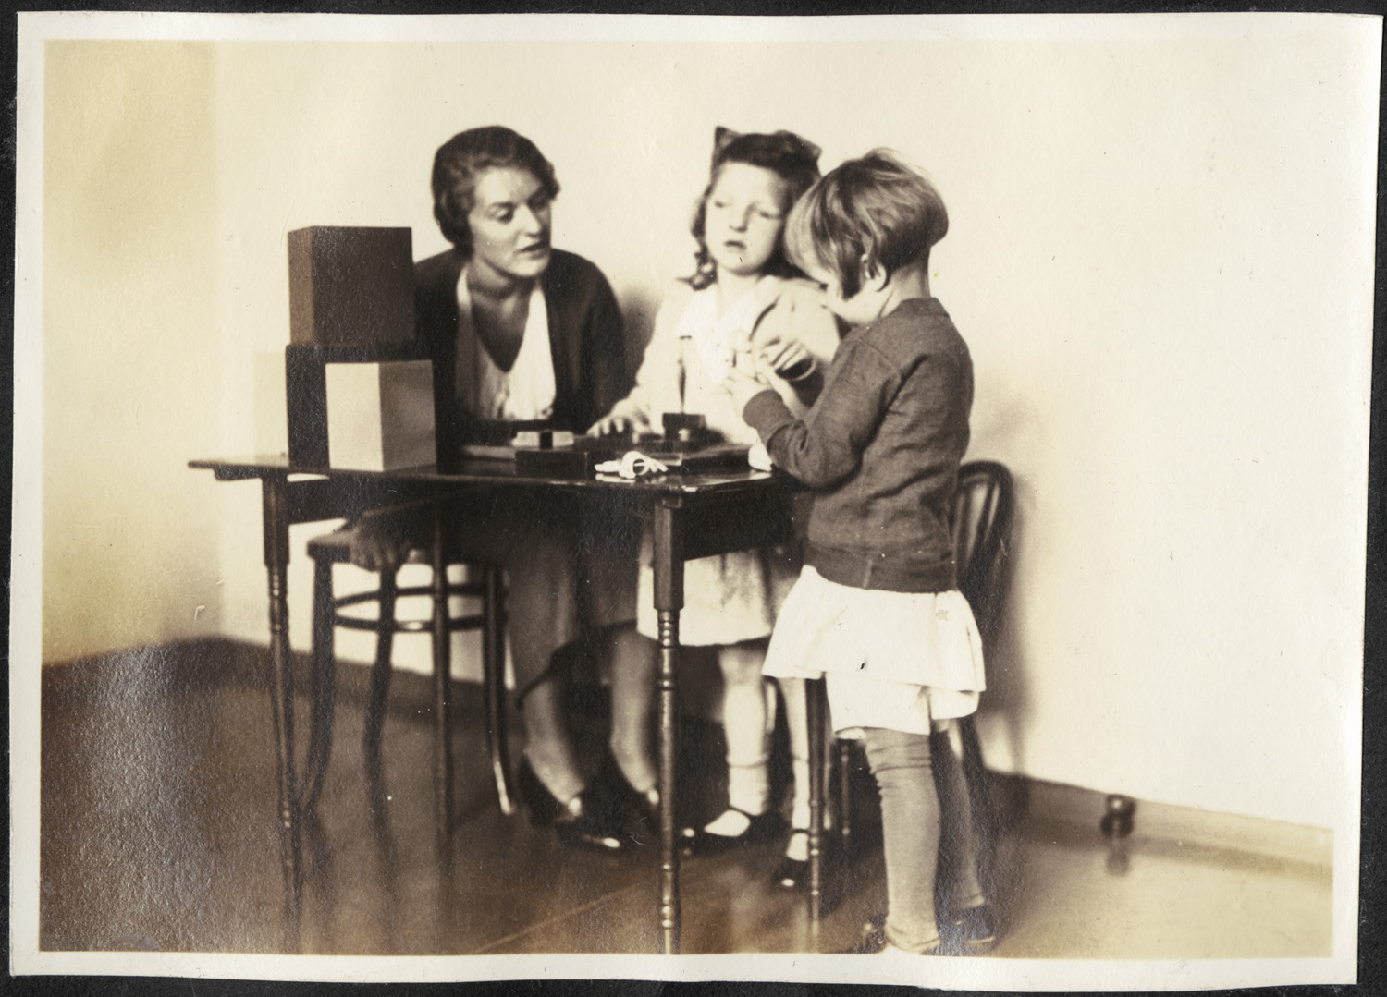
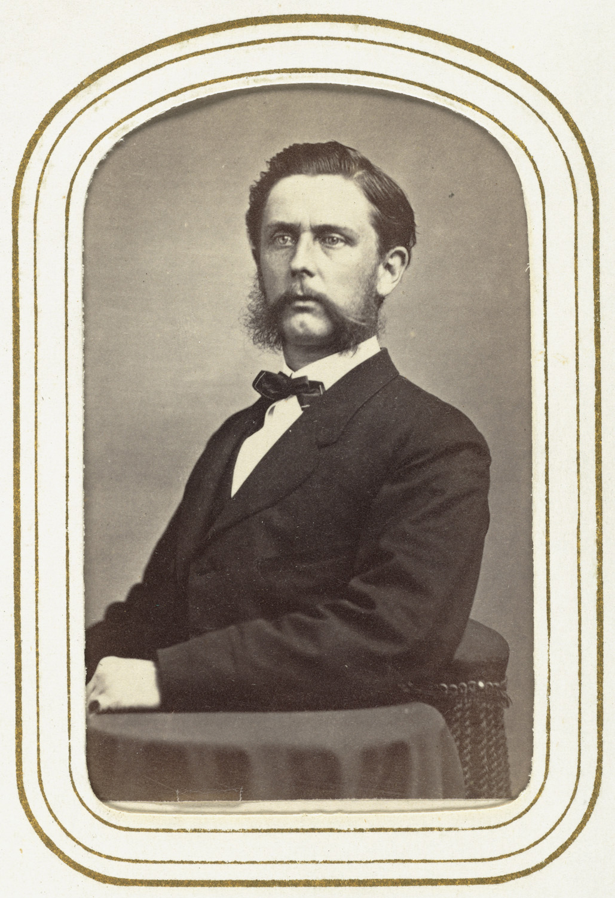
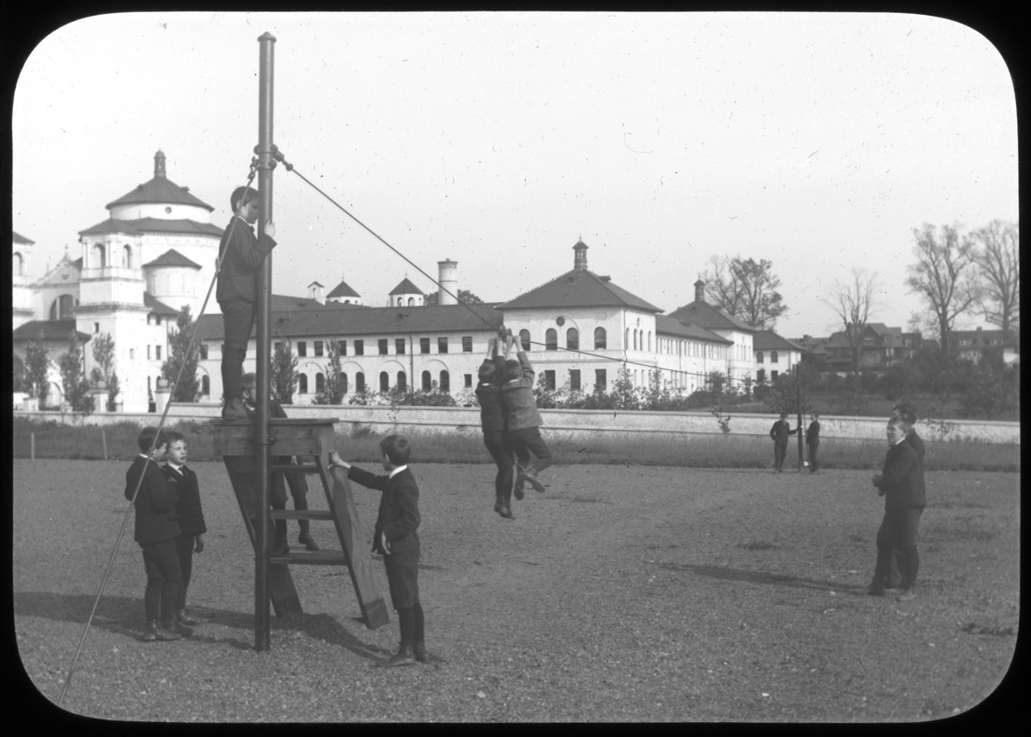
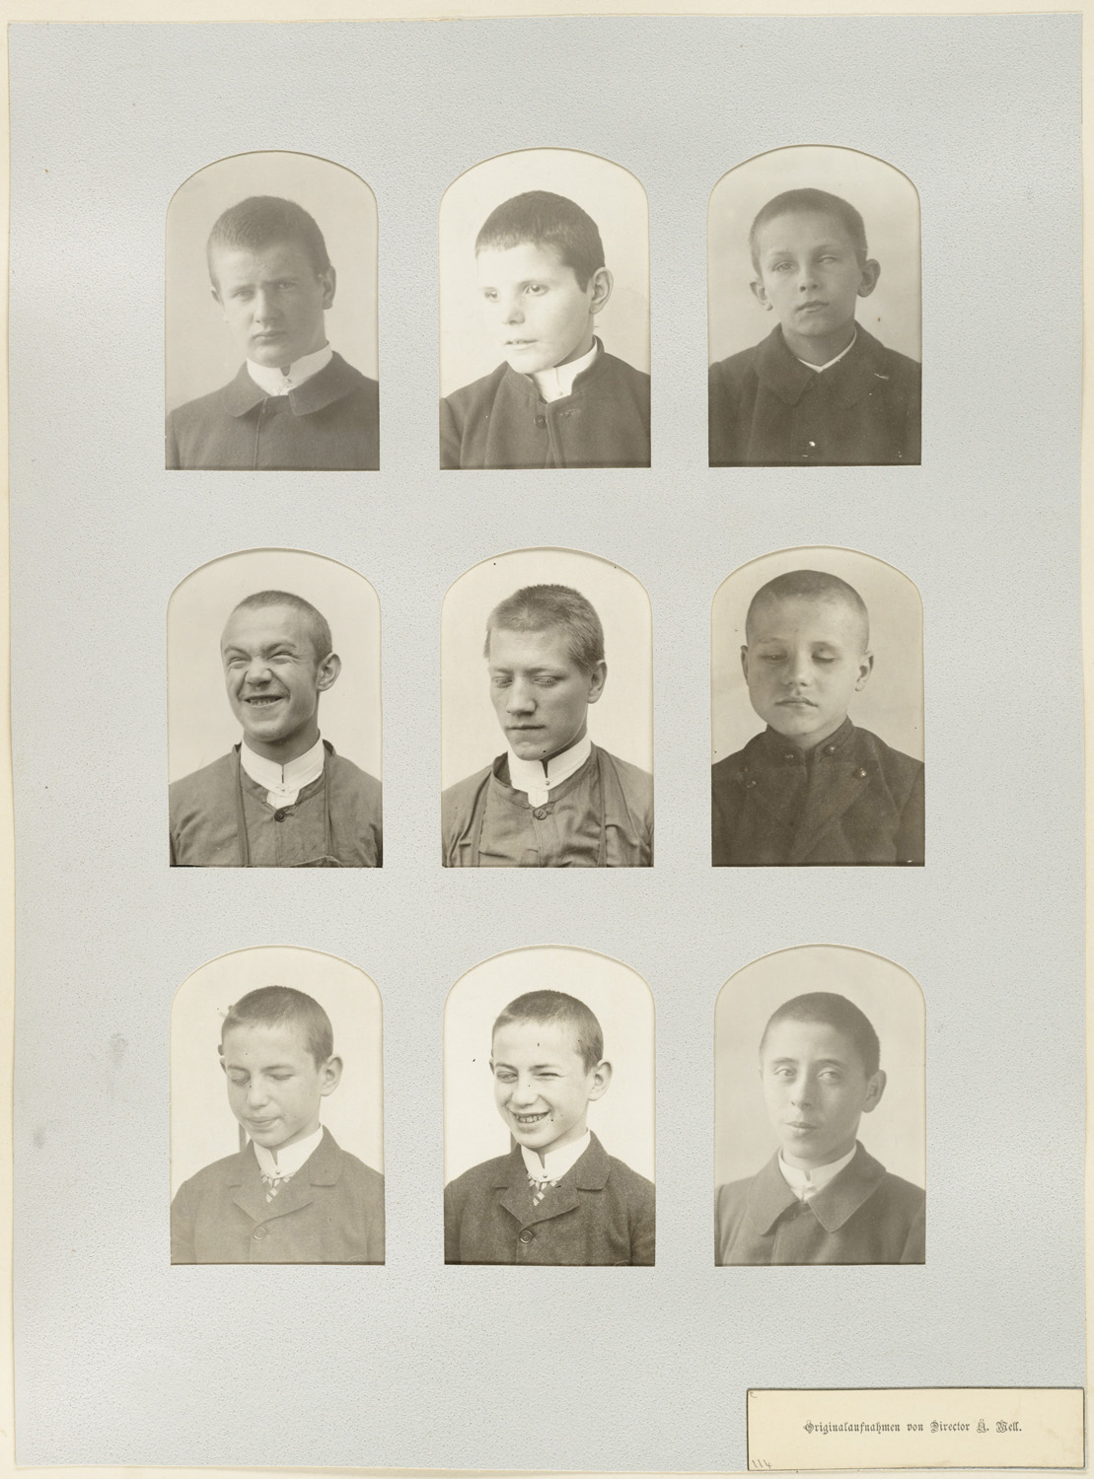
Perkins School for the Blind

Slide 27
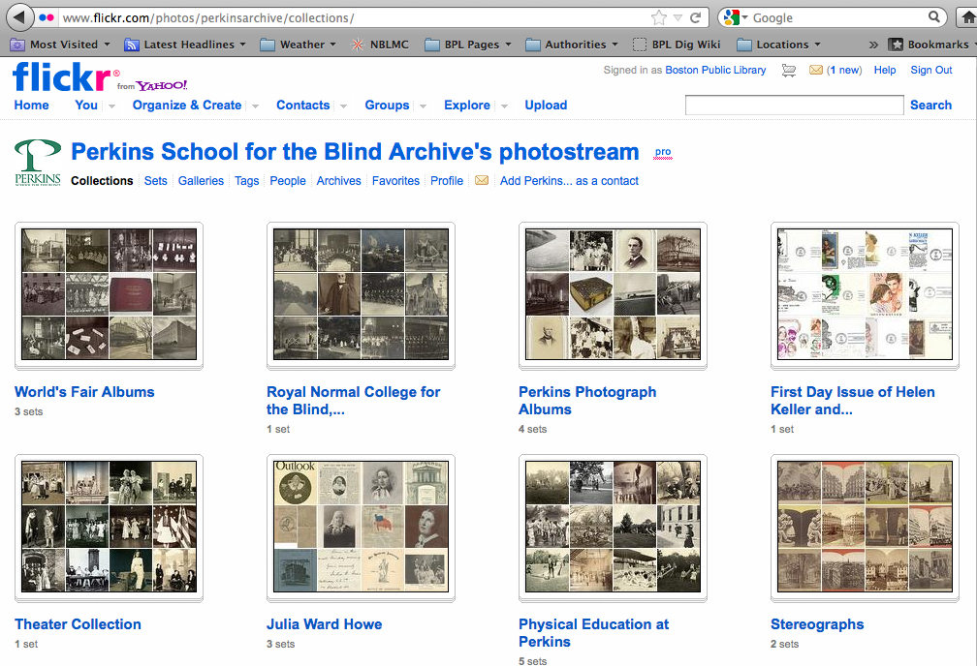
Perkins School for the Blind

Slide 28
Perkins School for the Blind
Notes:
Perkins Photograph Albums
Portrait Album
Perkins Album, circa 1893
Perkins Album, 1913
Perkins Album, circa 1932
Royal Normal College for the Blind, England
World's Fair Albums
Kindergarten Department Album, World's Columbian Exposition, 1893
Boys' Department, Primary and Kindergarten, Perkins Institution, St. Louis Exposition Album
Girls' Department, Primary and Kindergarten, Perkins Institution, St. Louis Exposition Album

Slide 29
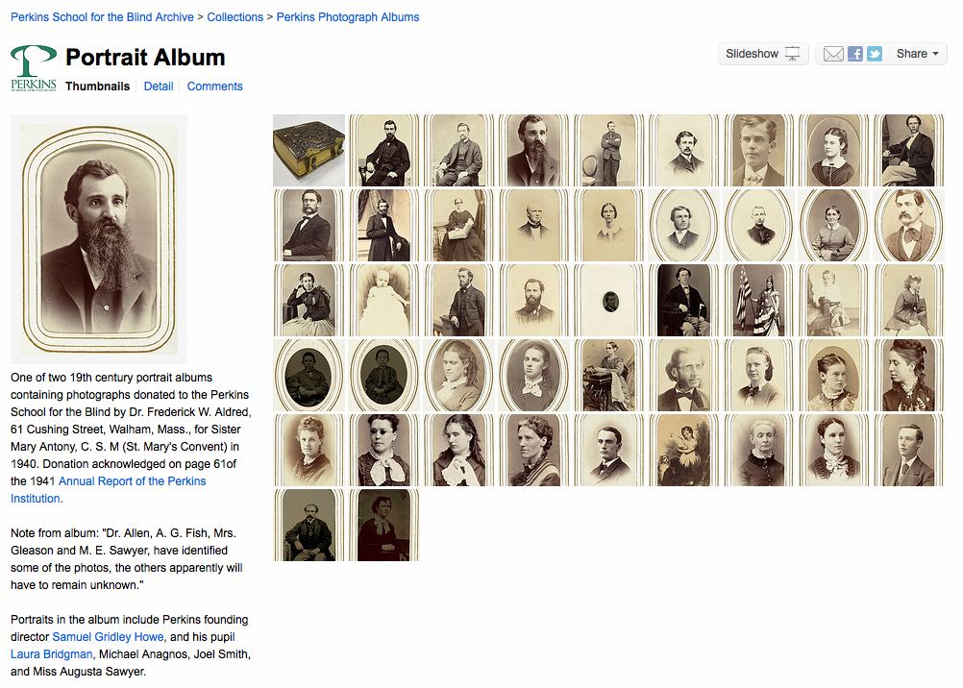
Perkins School for the Blind

Slide 30
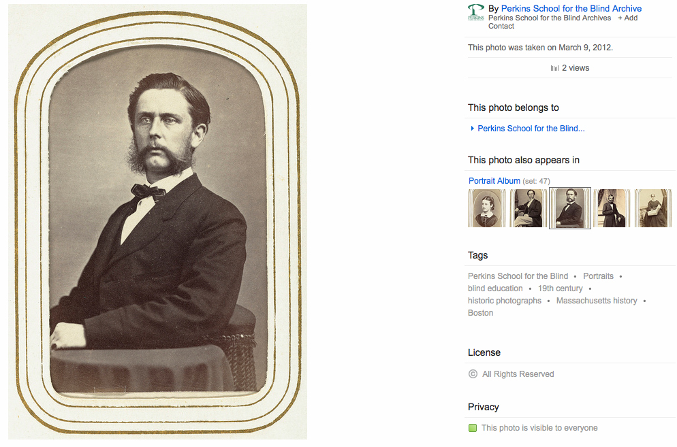
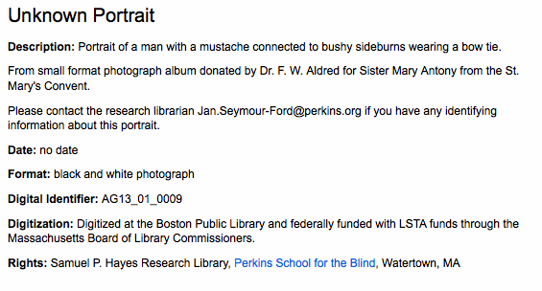
Perkins School for the Blind

Slide 31
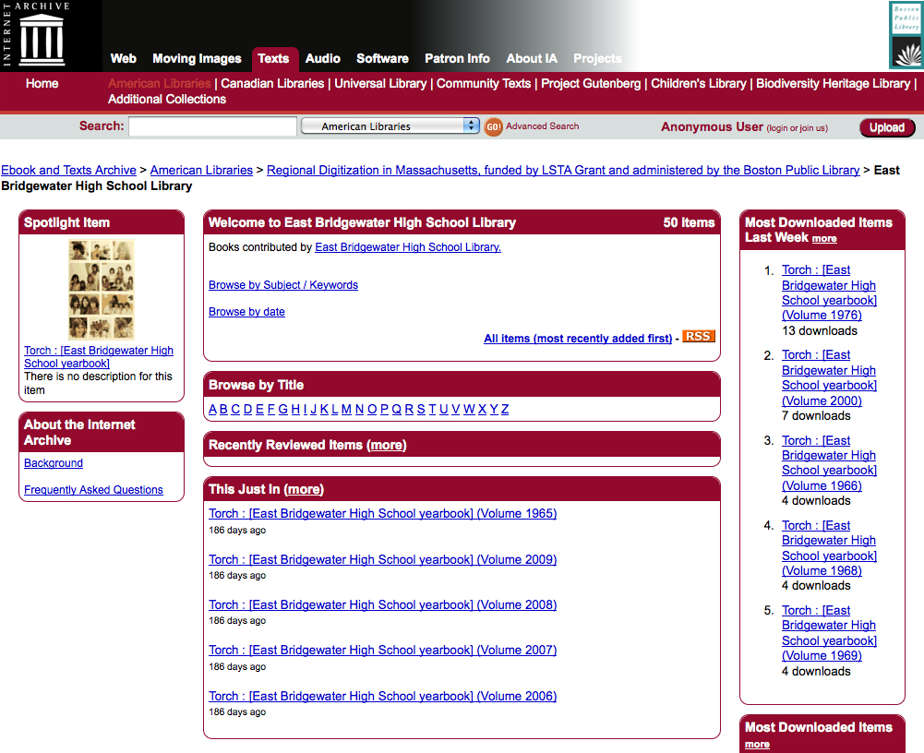
East Bridgewater High School

Slide 32
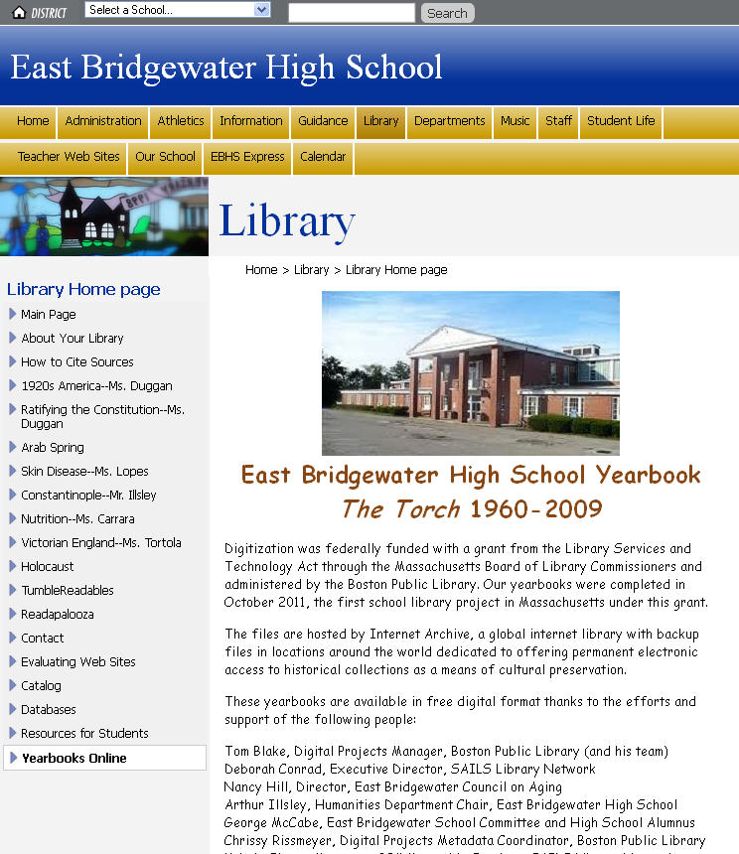
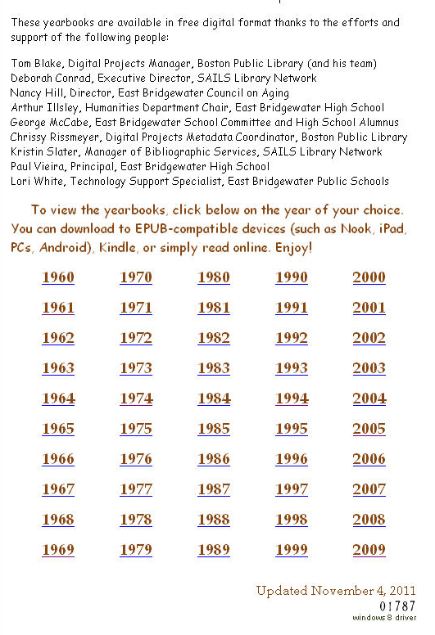
East Bridgewater High School

Slide 33
East Bridgewater High School

Slide 34
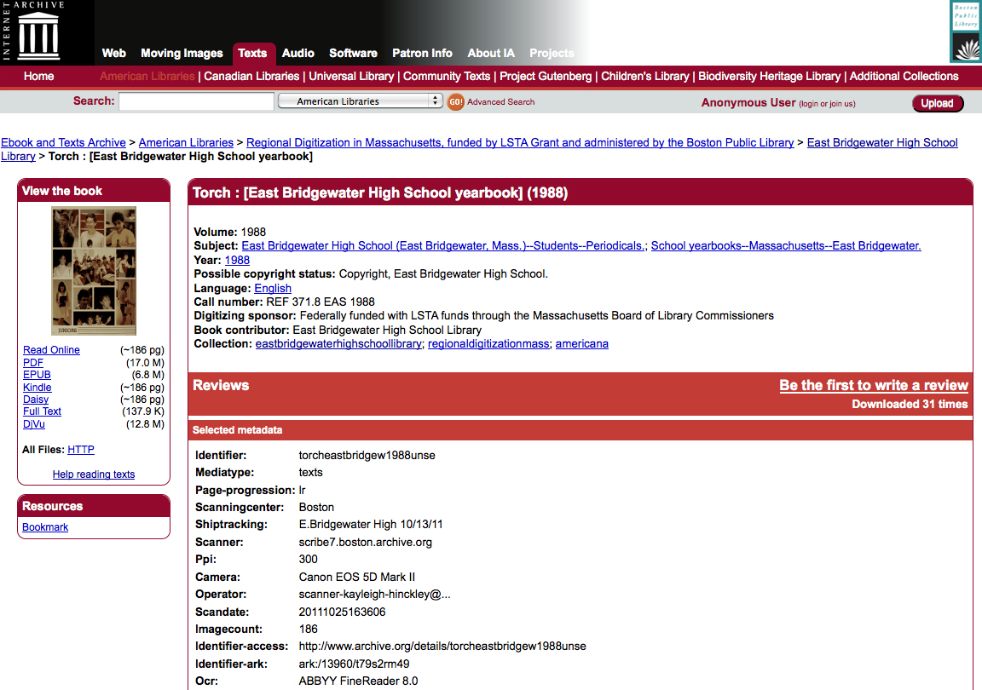
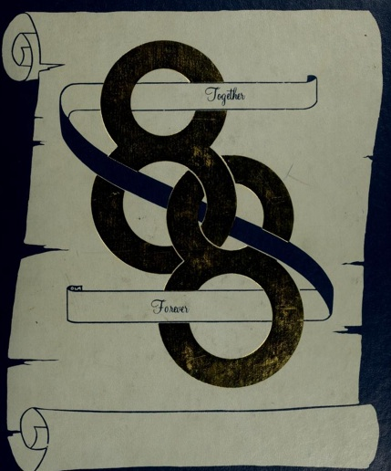
East Bridgewater High School

Slide 35
East Bridgewater High School

Slide 36
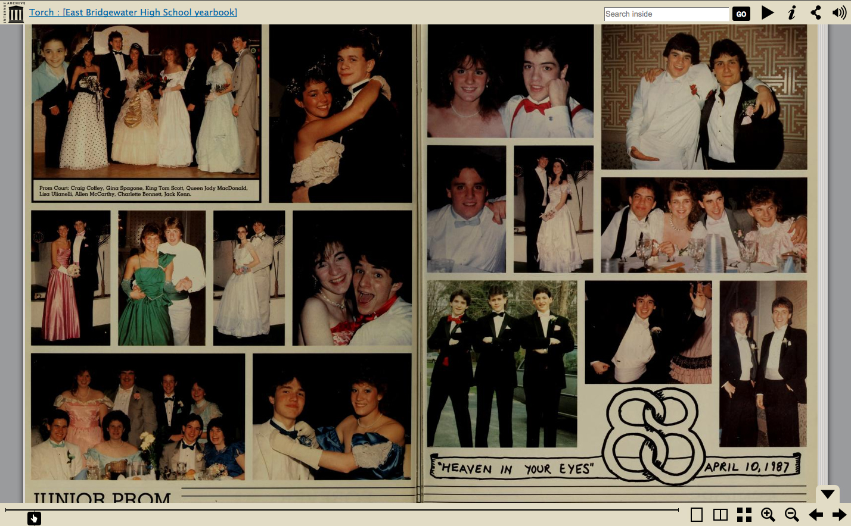
East Bridgewater High School

Slide 37
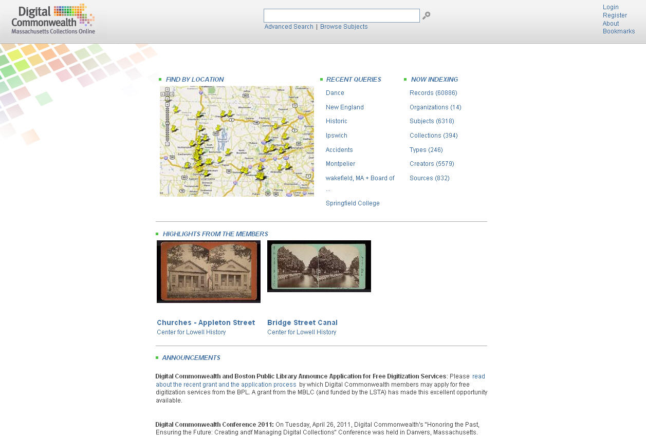
Notes:
DON’T mention what DC can’t handle or do!!!
Just say everything that is digitized will eventually go into Digital Commonwealth portal and repository system.

Slide 38
